Slide 1

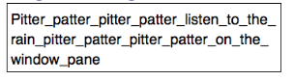

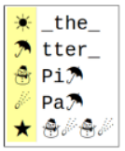
Unit 1 Lesson 9 - Activity
Prompt:
How is this message the same as the first? What actually gets sent to my friend?

