Slide 1

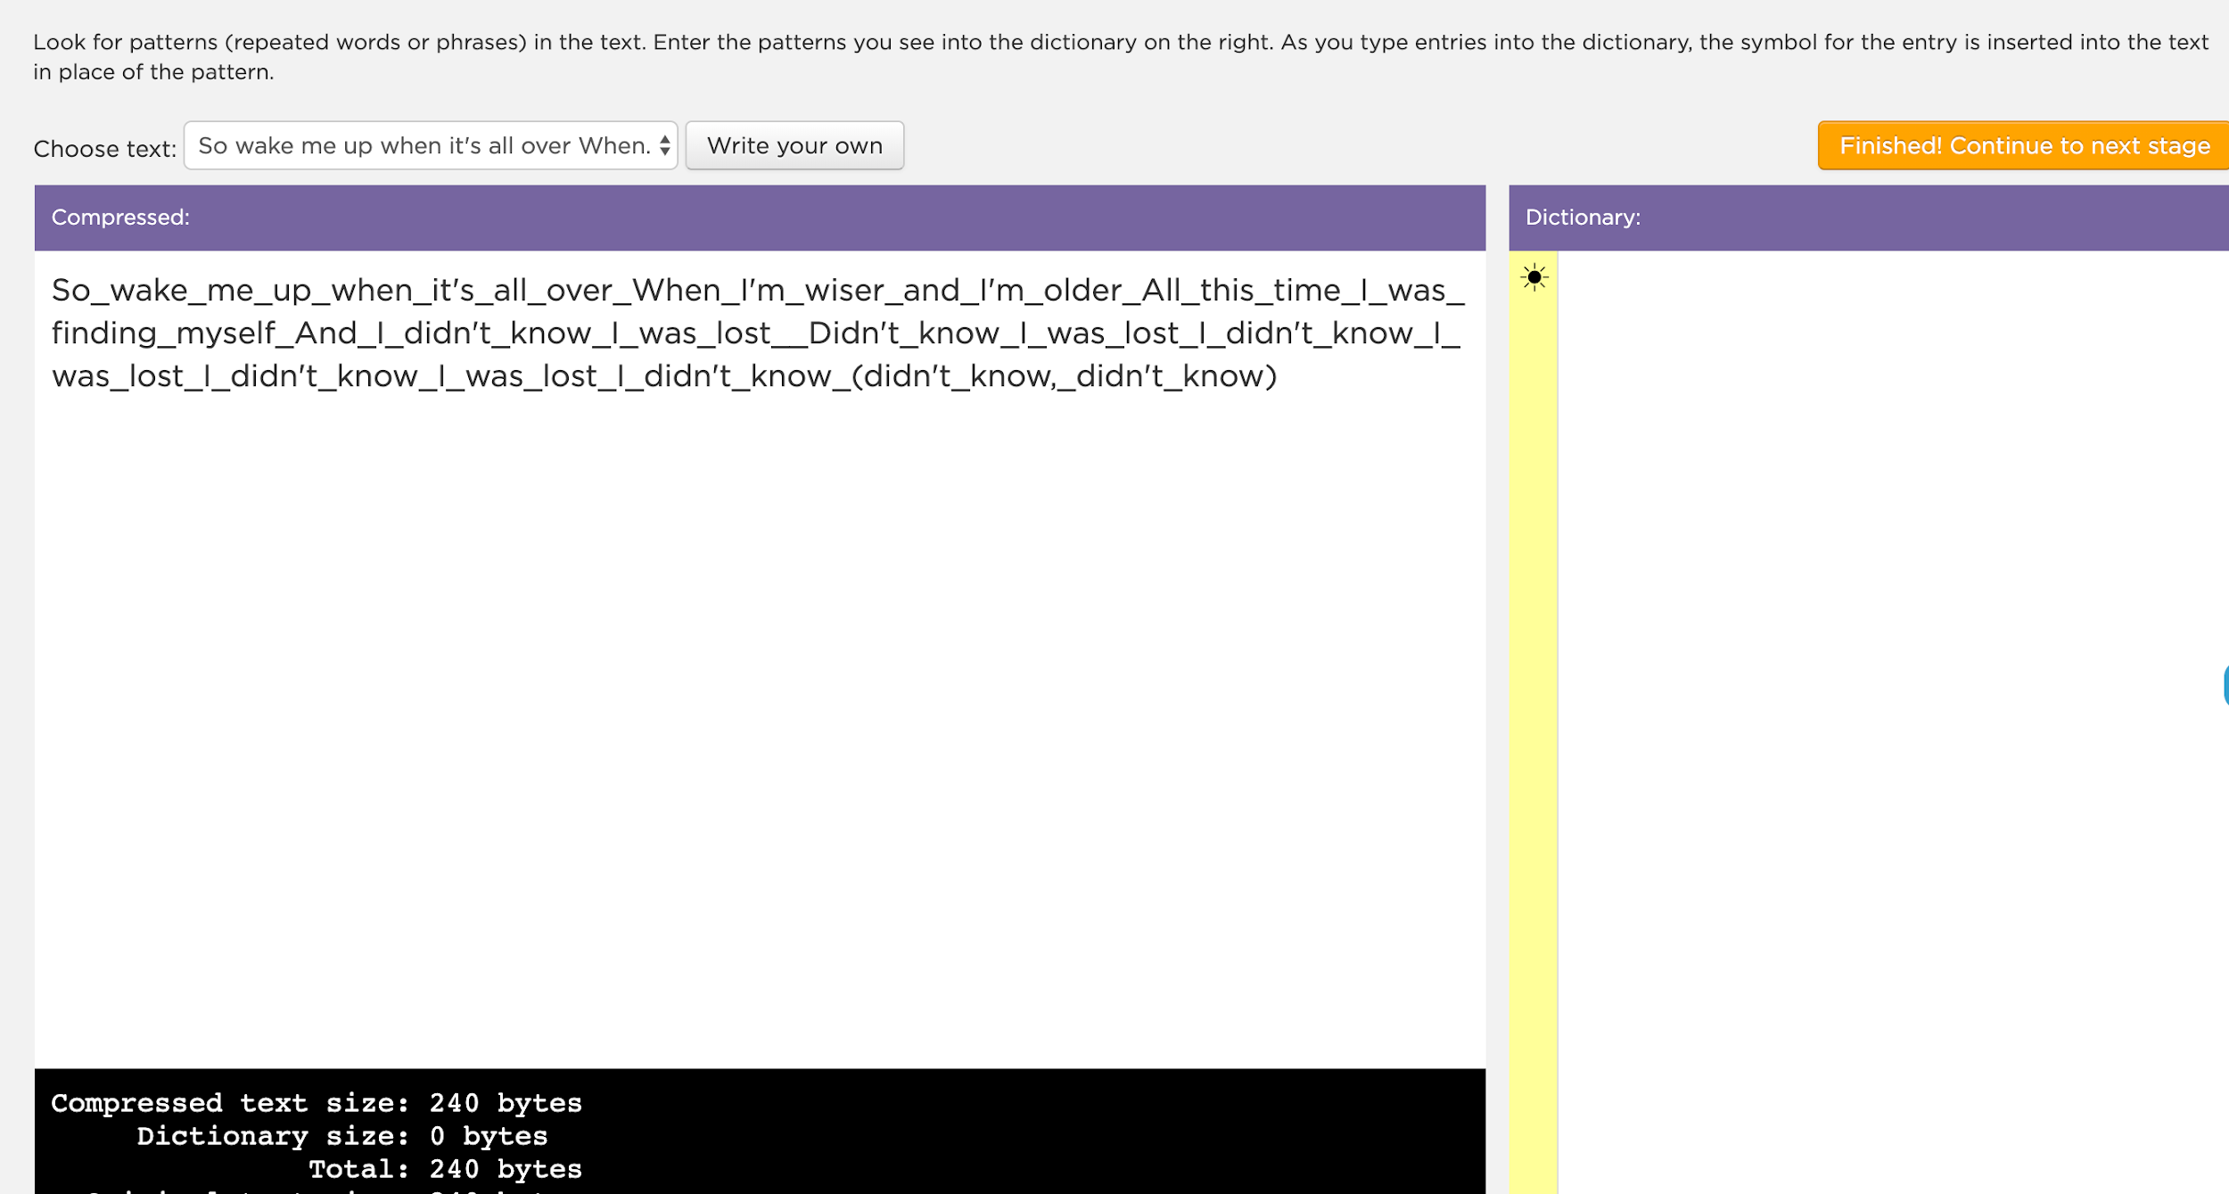
Unit 1 Lesson 9 - Activity
Text Compression Widget
Do This:
Navigate to Code Studio Lesson 9
Go to Level 1
Try to compress the text

