Slide 1

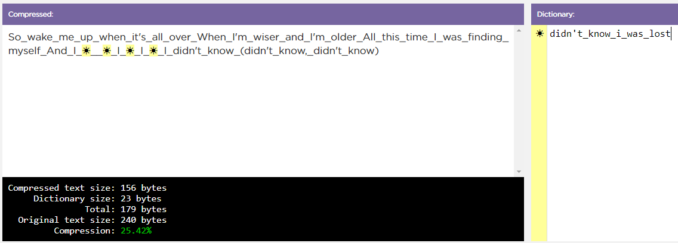
Unit 1 Lesson 9 - Activity
Make Note of your Compression Rating
Compression Rating

