Slide 1

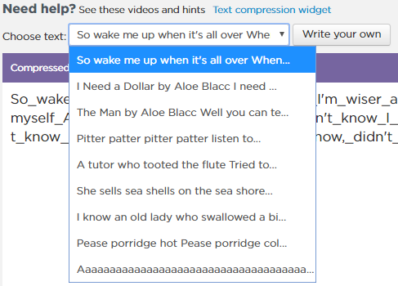
Unit 1 Lesson 9 - Activity
Click the Drop-Down Menu to explore other texts to compress
Be looking for texts you predict will be ‘easy’ to compress and texts you predict will be ‘difficult’

