Slide 1
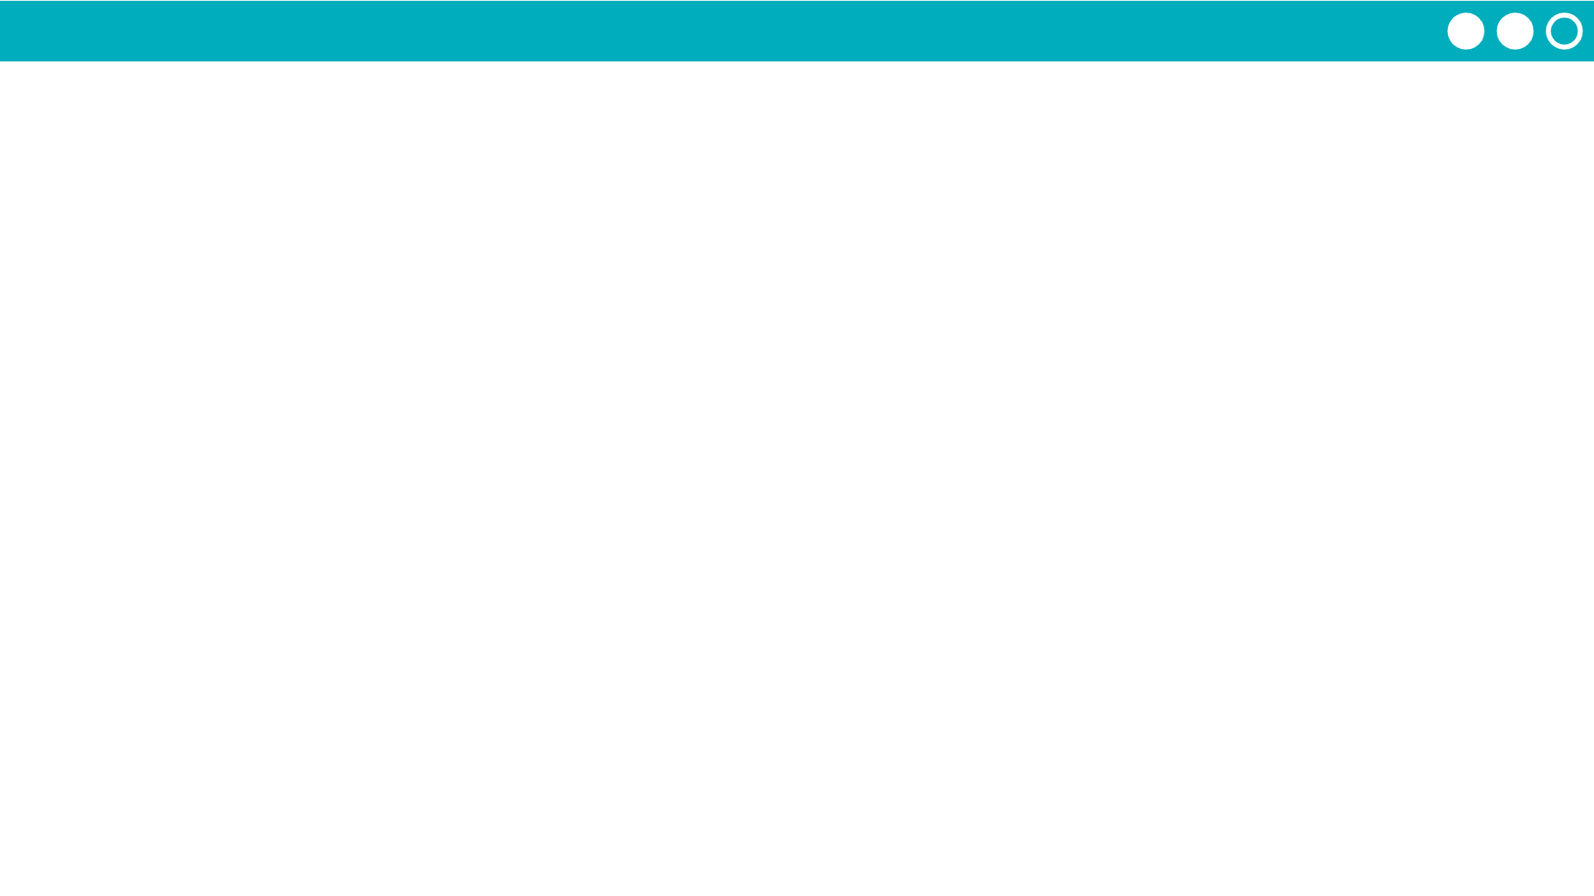
Unit 1 Lesson 10 - Activity
Do This:
Navigate to Code Studio, Lesson 10
Go to Level 1

