Slide 1

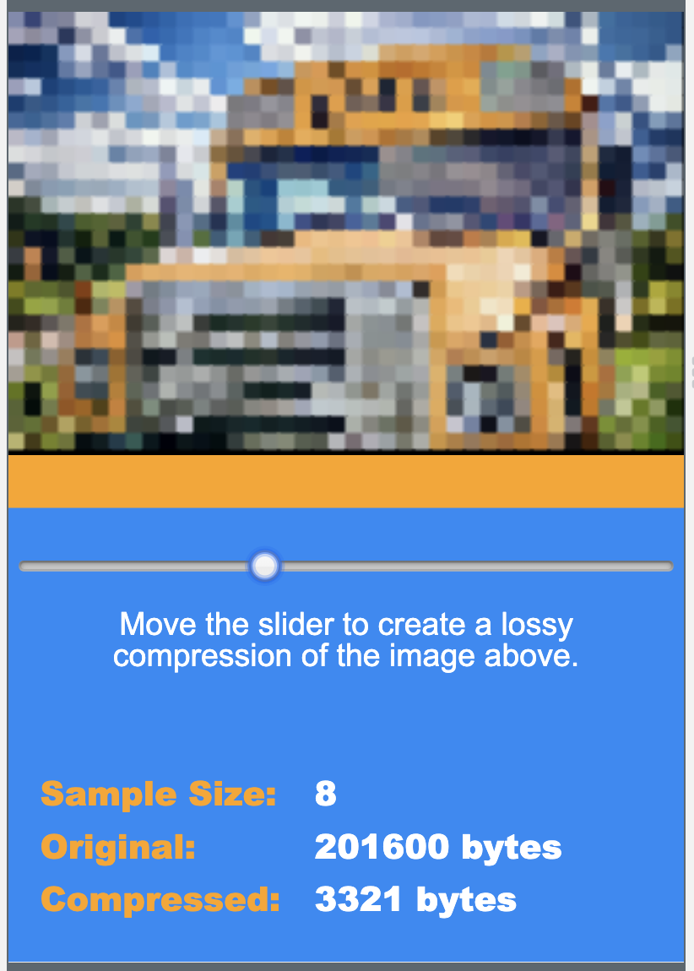
Unit 1 Lesson 10 - Activity
Lossy Compression Widget, v1 - Level 1
Prompt:
What do you notice about the quality of the image when you compress it?
What do you notice about the compressed file size?

