Slide 1

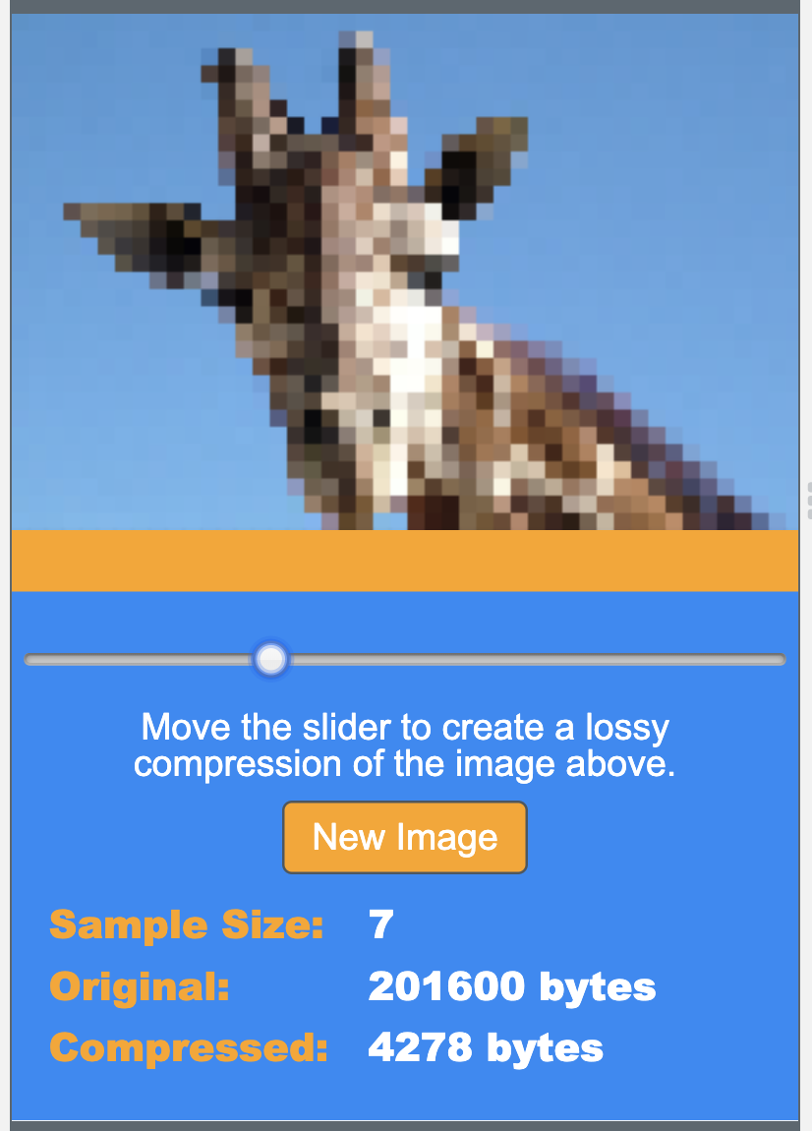
Unit 1 Lesson 10 - Activity
Lossy Compression Widget, v2 - Level 2

