Slide 1

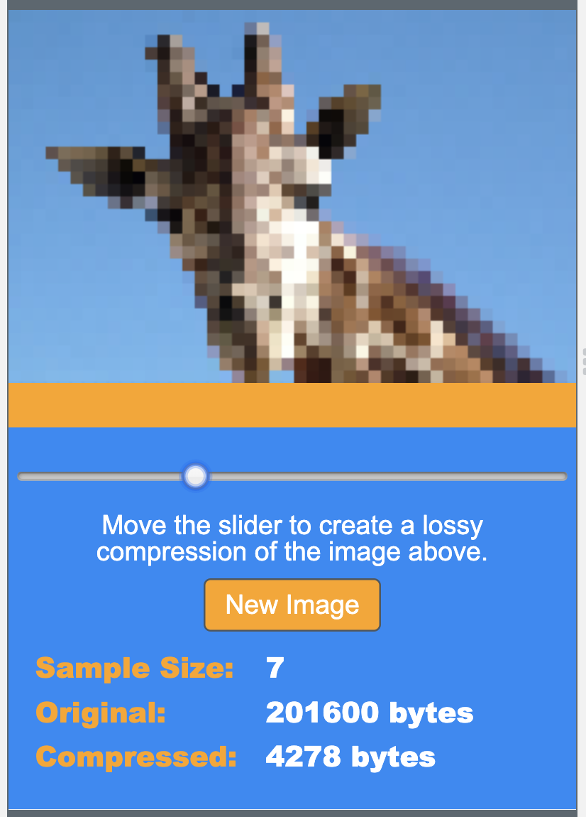
Unit 1 Lesson 10 - Activity
Share Out
Do This:
Share out the compressions you have made with students nearby. Try to guess the images!

