Slide 1


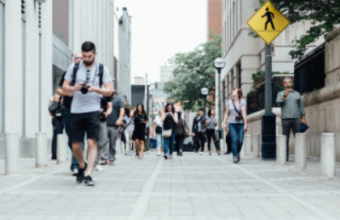
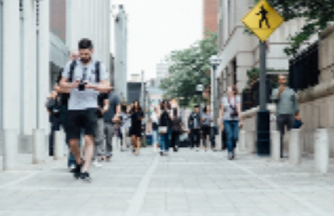
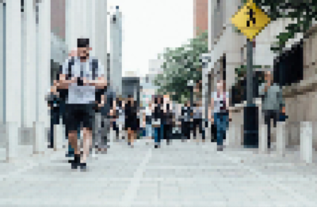
Unit 1 Lesson 10 - Activity
Scenario 3: This image is part of a satellite imaging assignment for the military, being used for intelligence gathering
1 - No compression (original image)
2 - Small amount of compression
3 - Medium amount of compression
4 - Large amount of compression
Vote!

