Slide 1

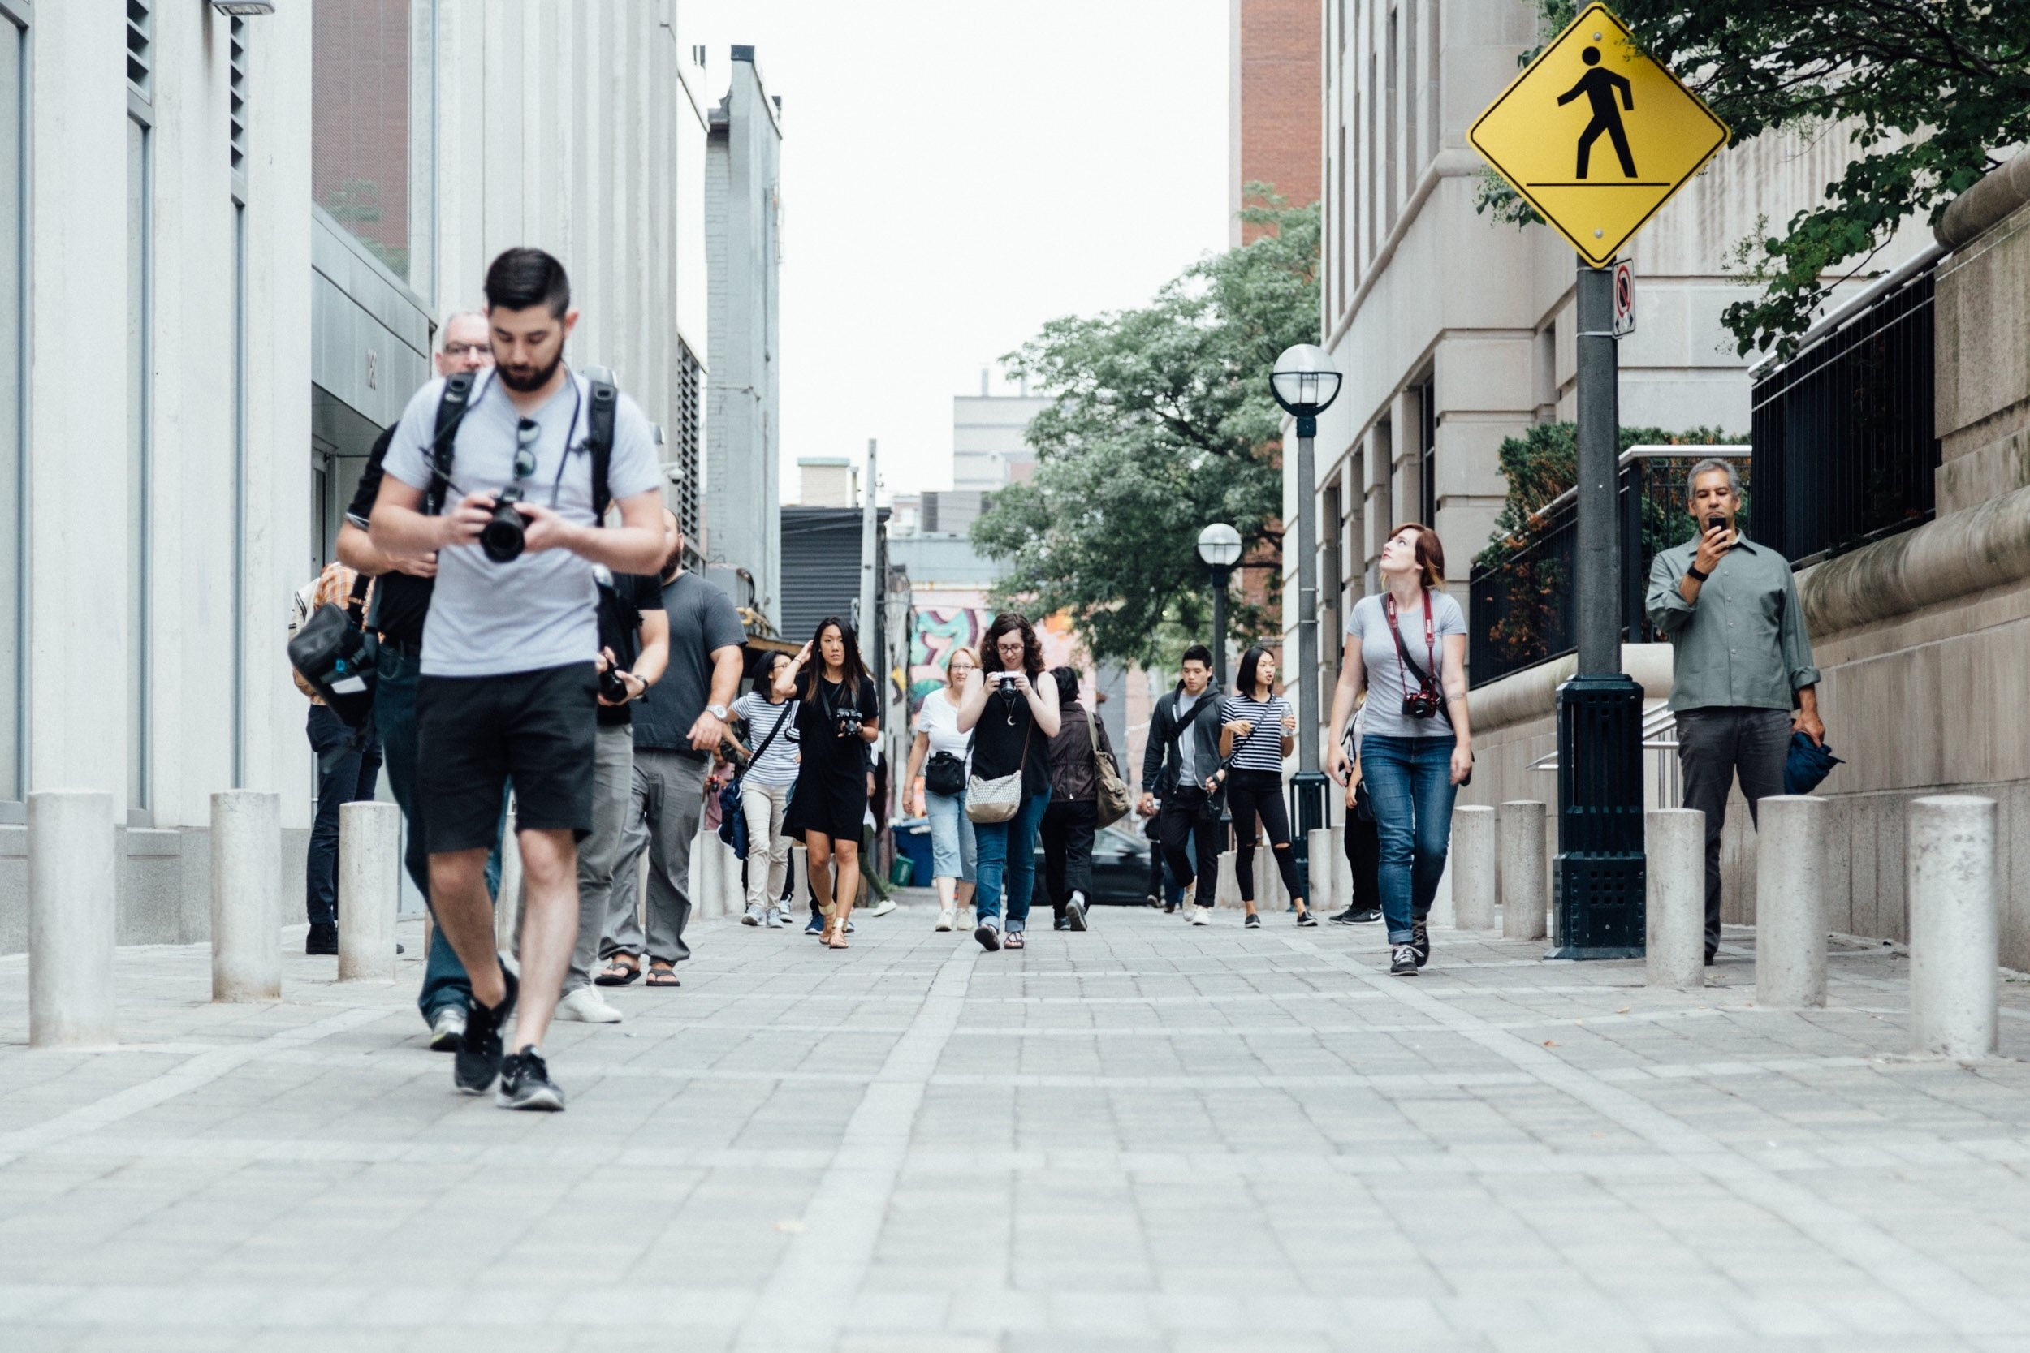
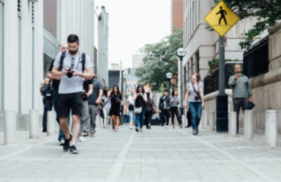


Unit 1 Lesson 10 - Activity
Scenario 4: You are a Social Media manager posting this to an Instagram story for an event happening right now
1 - No compression (original image)
2 - Small amount of compression
3 - Medium amount of compression
4 - Large amount of compression
Vote!

