Slide 1

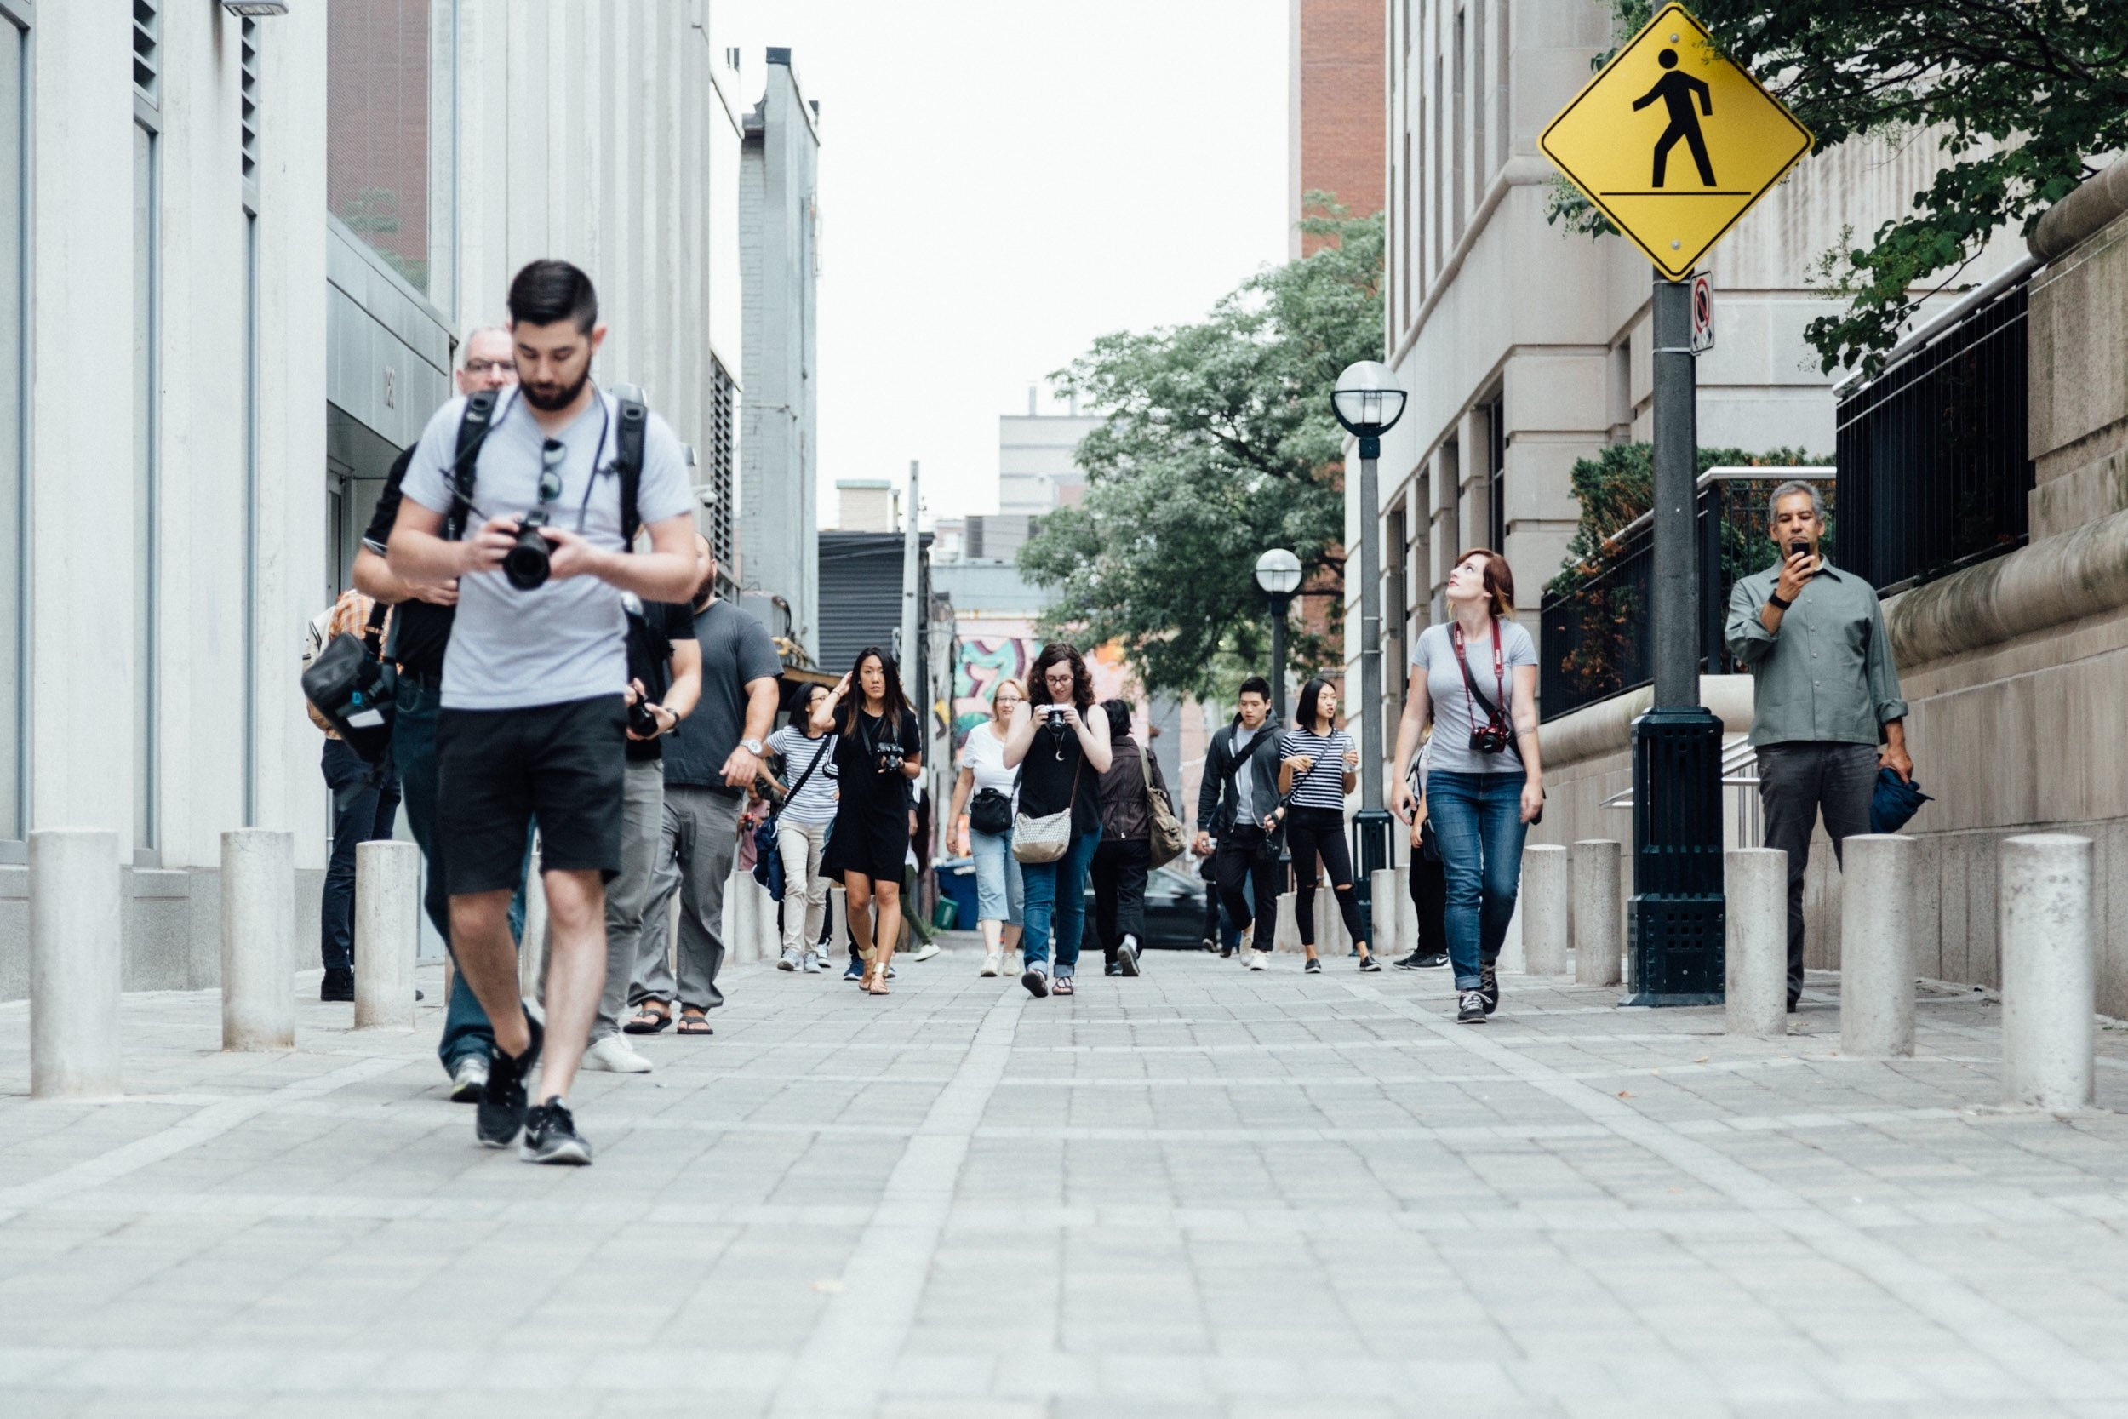
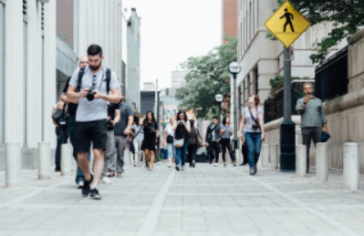
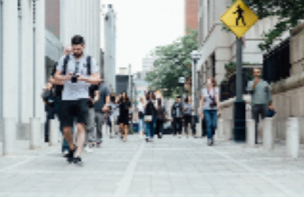
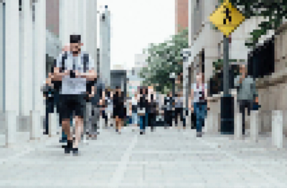
Unit 1 Lesson 10 - Activity
Scenario 5: This image will be part of a collage where 100 copies will be stitched together to make a larger image
1 - No compression (original image)
2 - Small amount of compression
3 - Medium amount of compression
4 - Large amount of compression
Vote!

