Slide 1

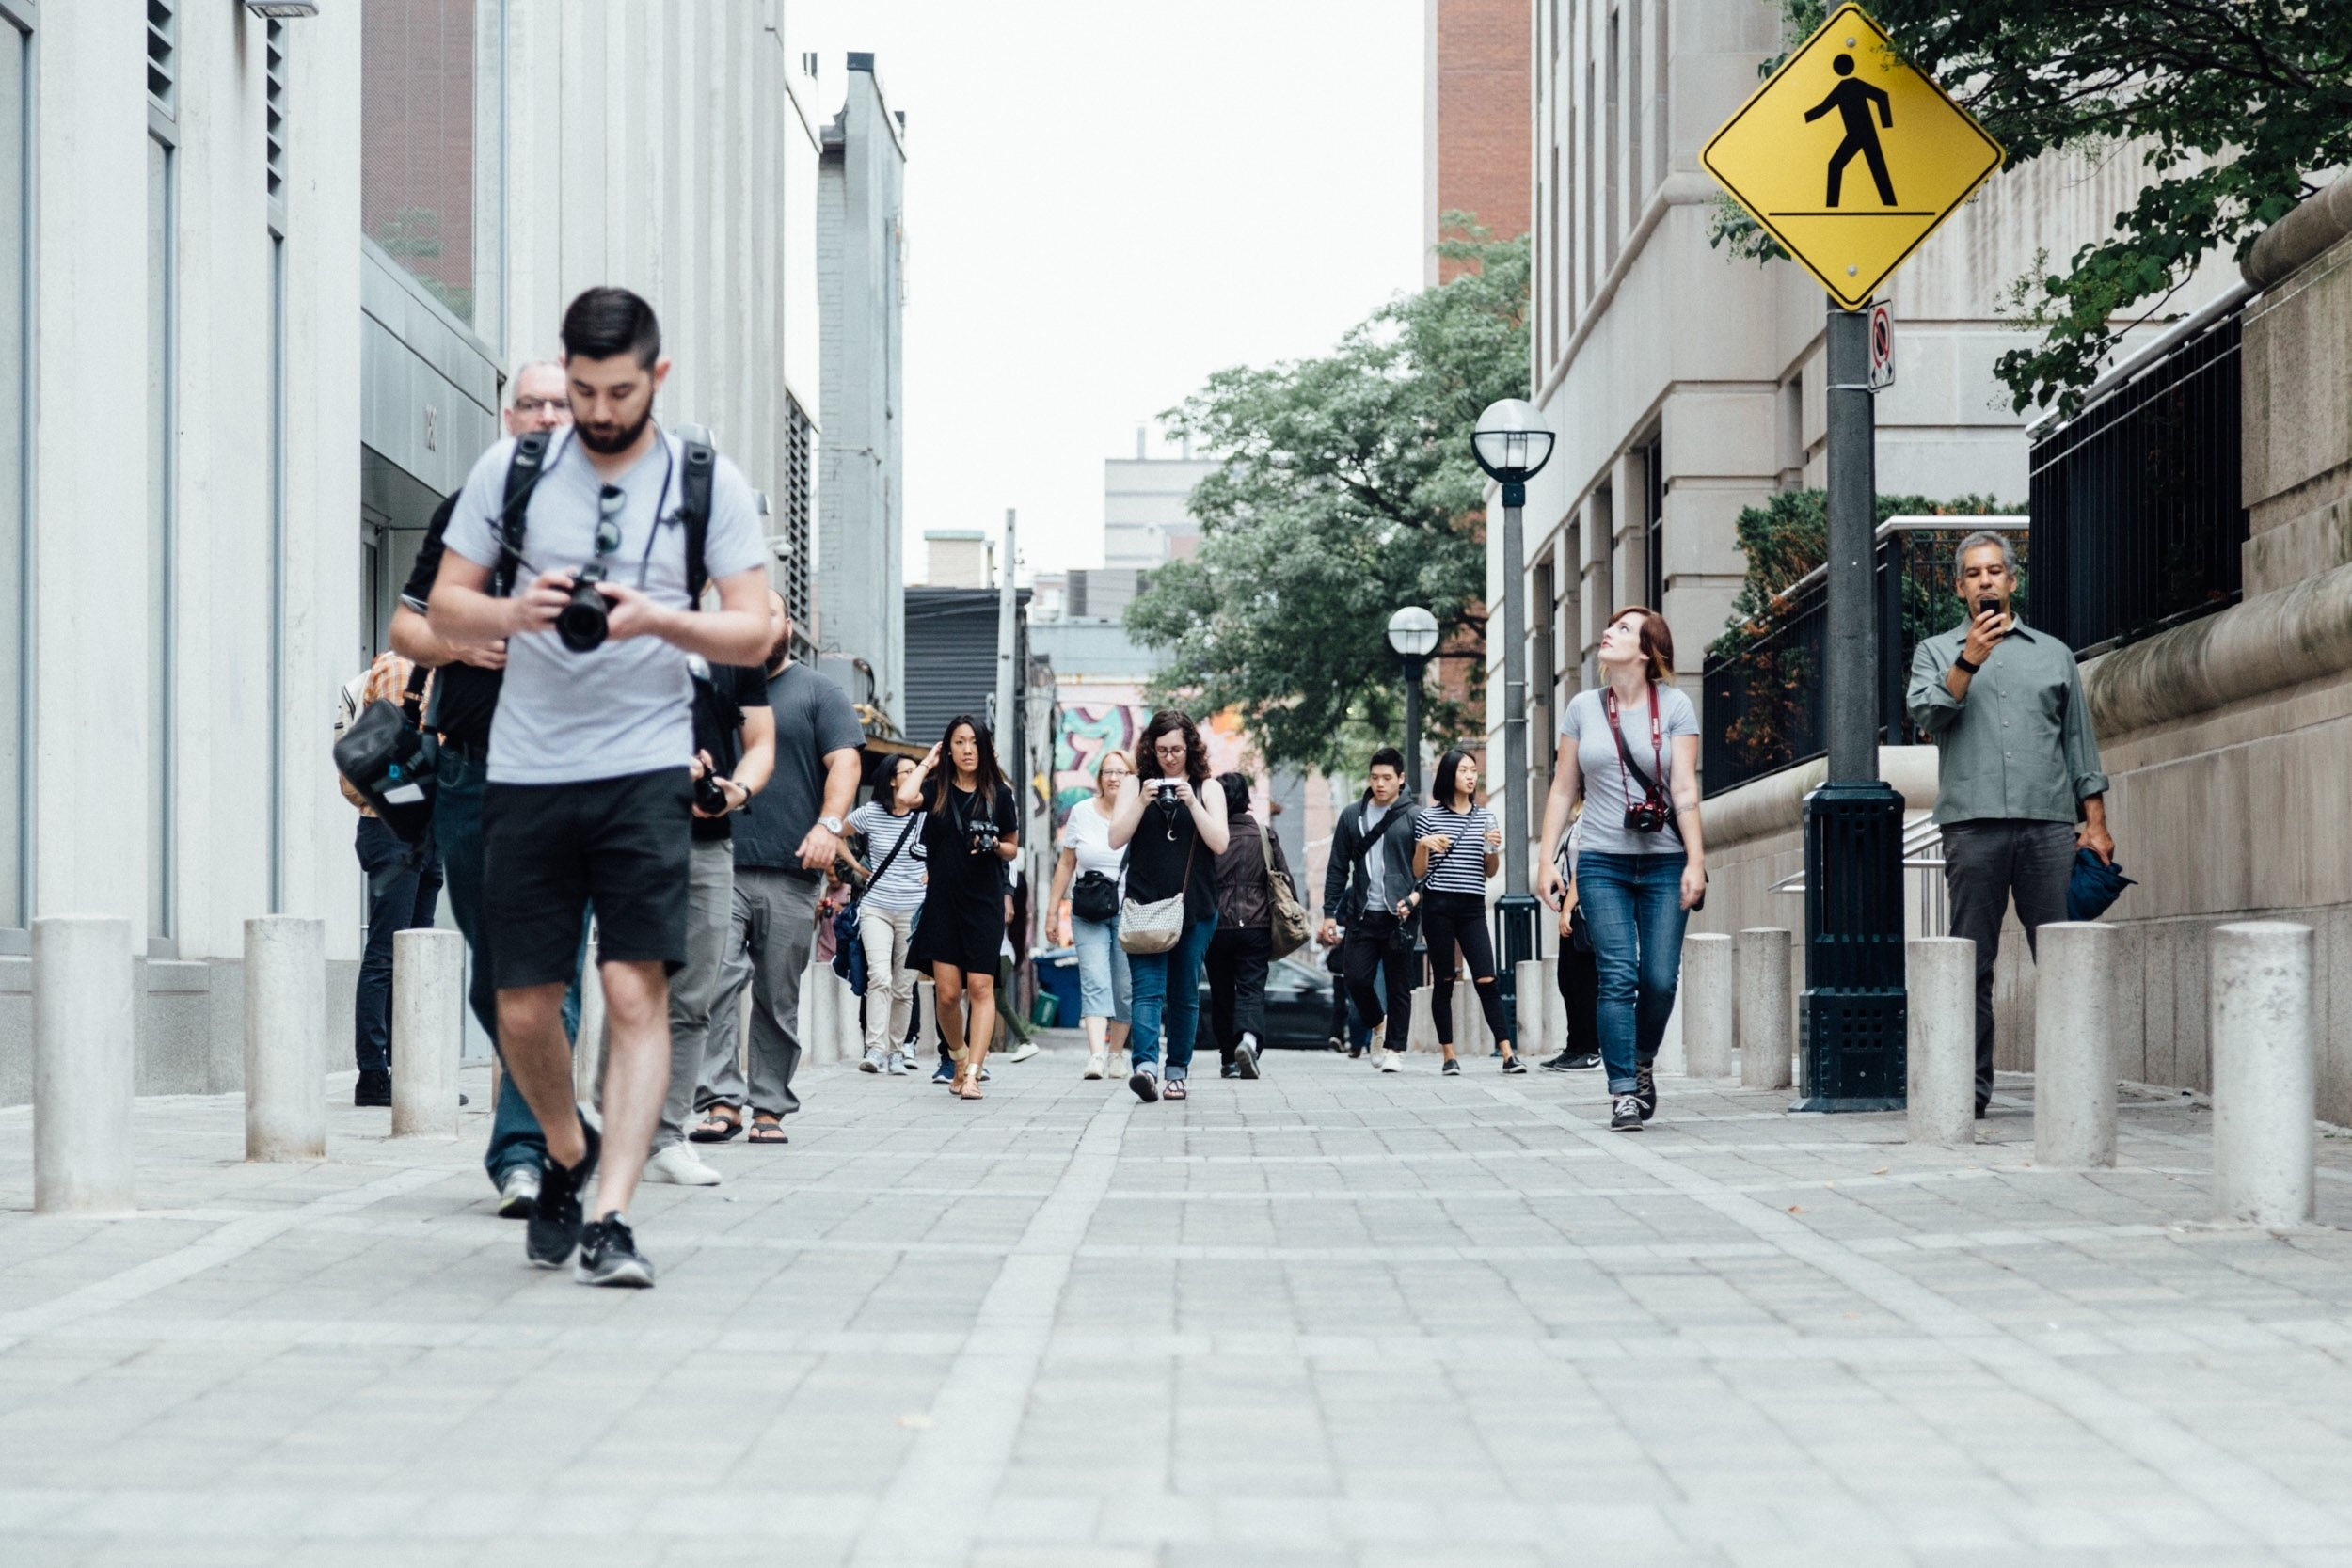
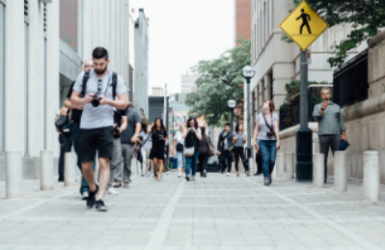
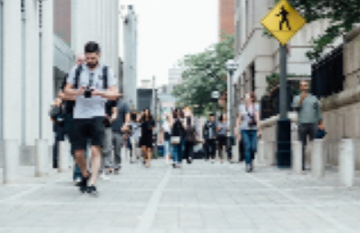
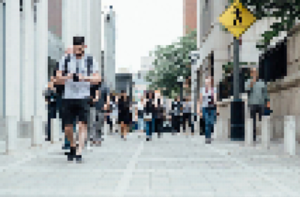
Unit 1 Lesson 10 - Activity
Scenario 6: You are a professional photographer submitting to a design competition where your submission will be carefully judged for color & composition
1 - No compression (original image)
2 - Small amount of compression
3 - Medium amount of compression
4 - Large amount of compression
Vote!

