Slide 1


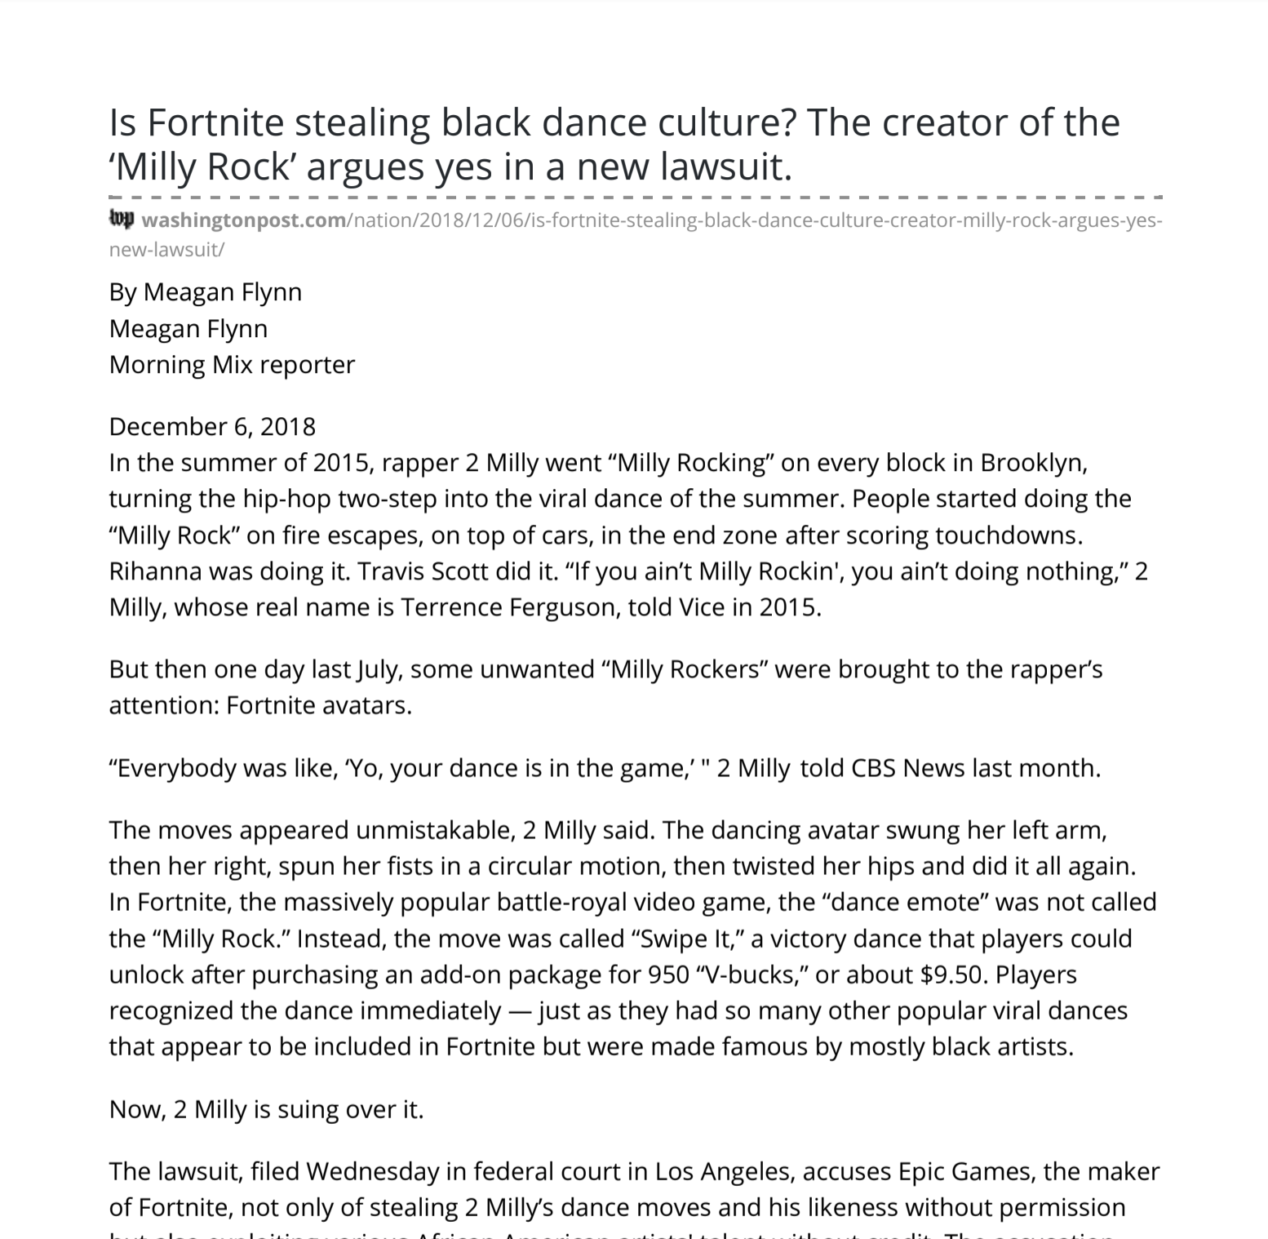
Unit 1 Lesson 11 - Activity
Copyright Investigation
You should have:
A copy of the article
Pens or pencils

