Slide 1
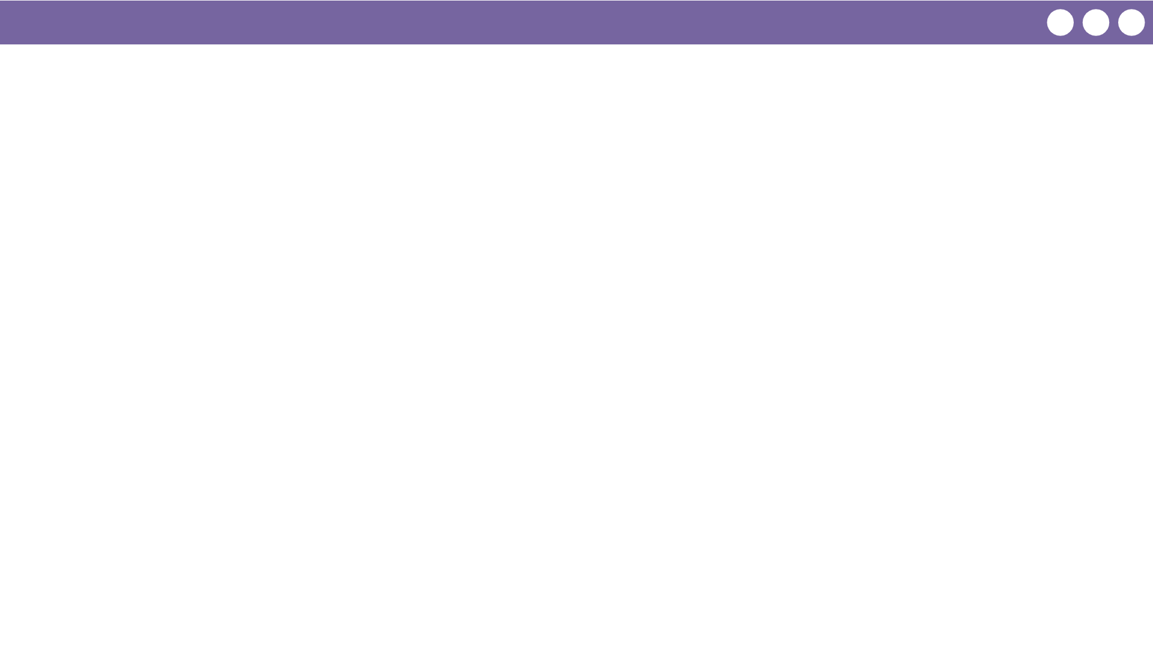
Unit 1 Lesson 1 - Wrap Up
Prompt:
What are you excited to learn about in this class?

