Slide 1


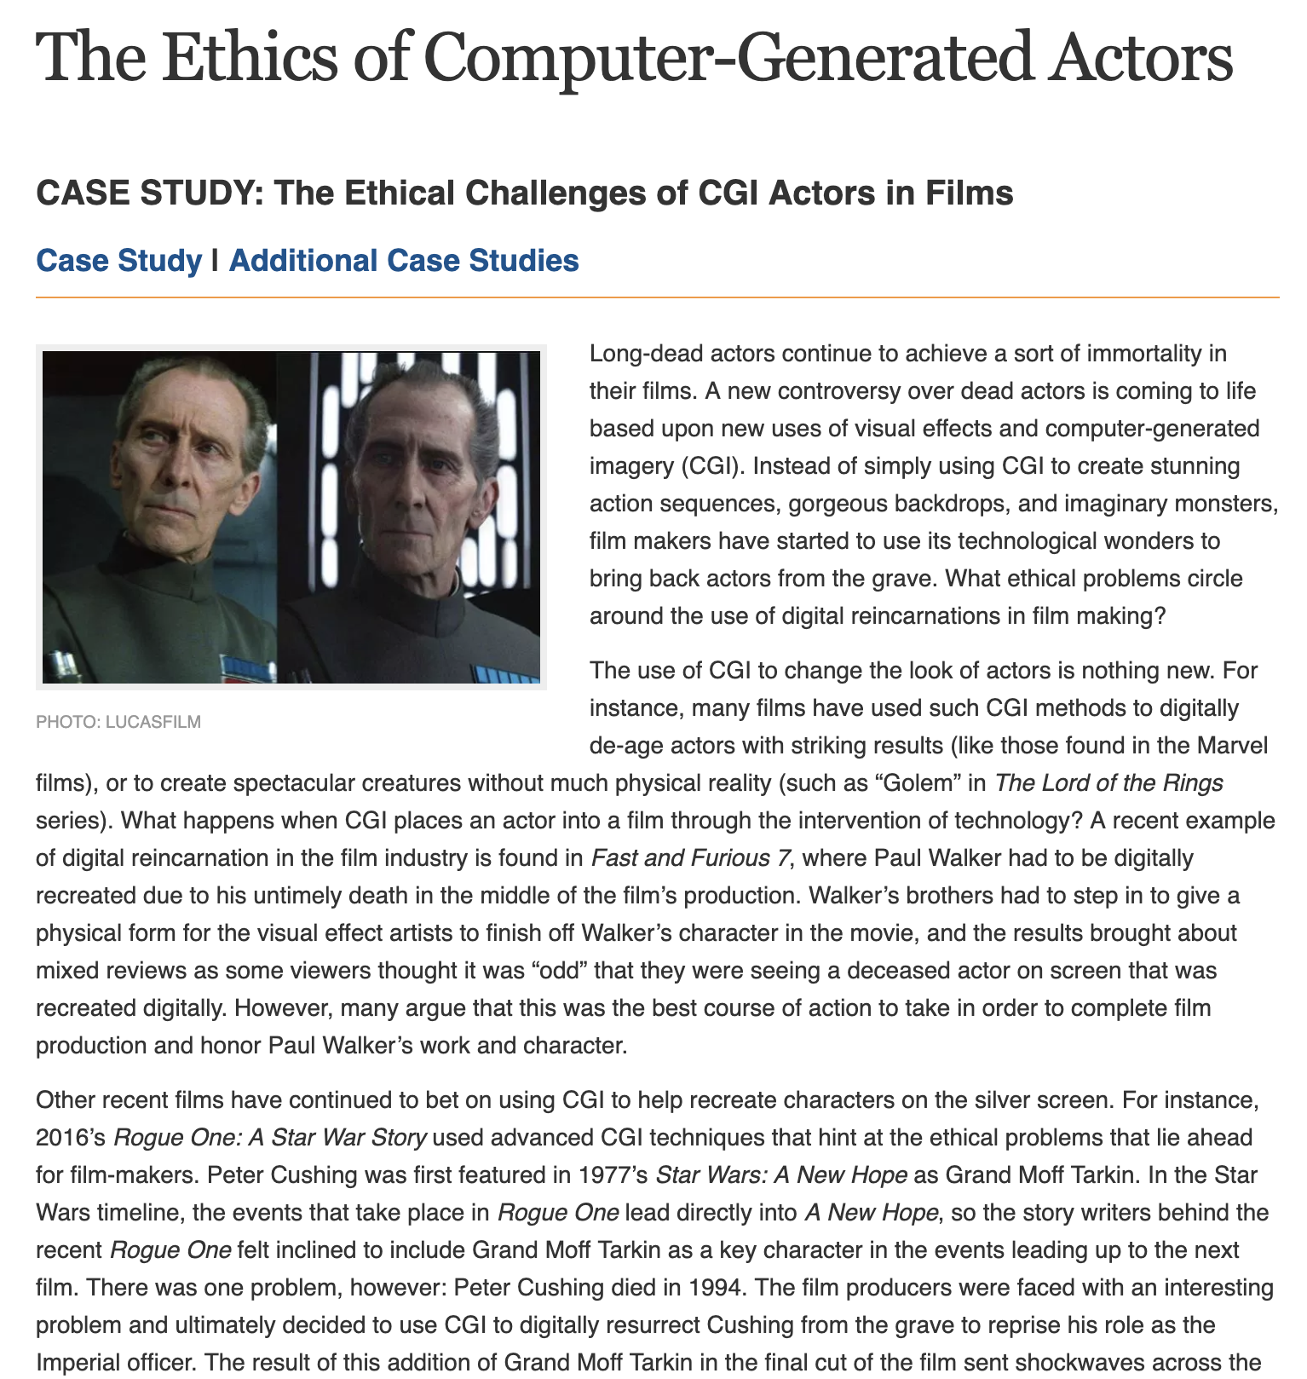
Unit 1 Lesson 12 - Activity
Digital Dilemmas, pt 1
You should have:
A copy of an article
Pens or pencils

