Slide 1
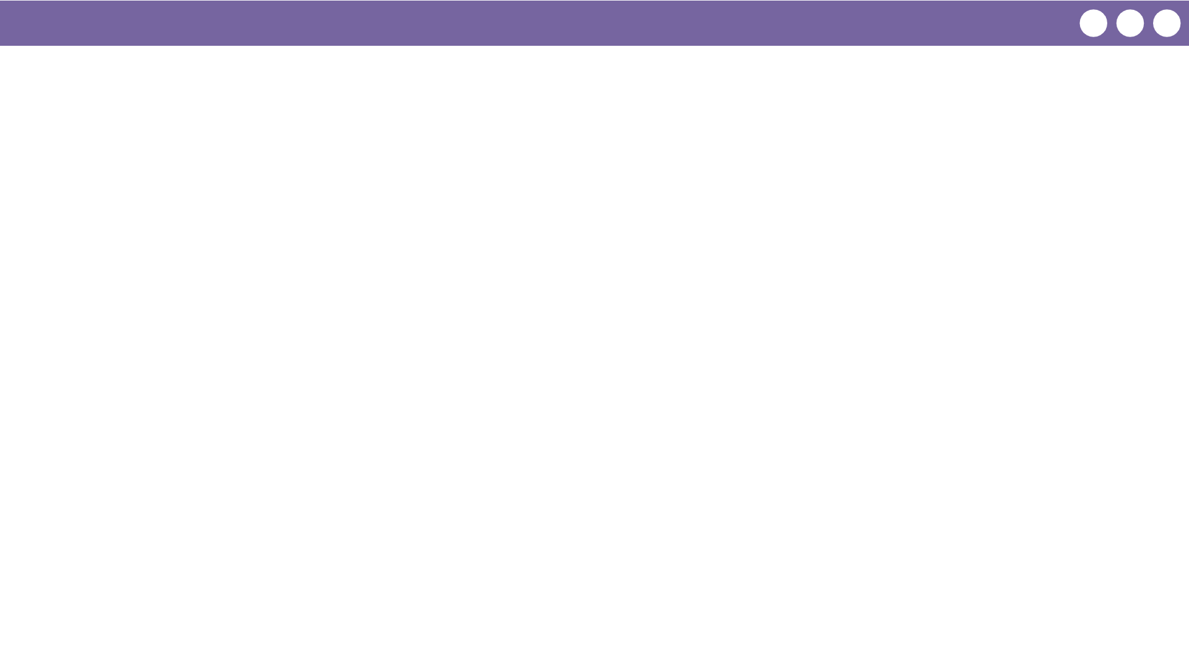
Unit 1 Lesson 13 - Wrap Up
Prompt:
Why should we care about information being represented digitally? How does this impact you personally?

