Slide 1
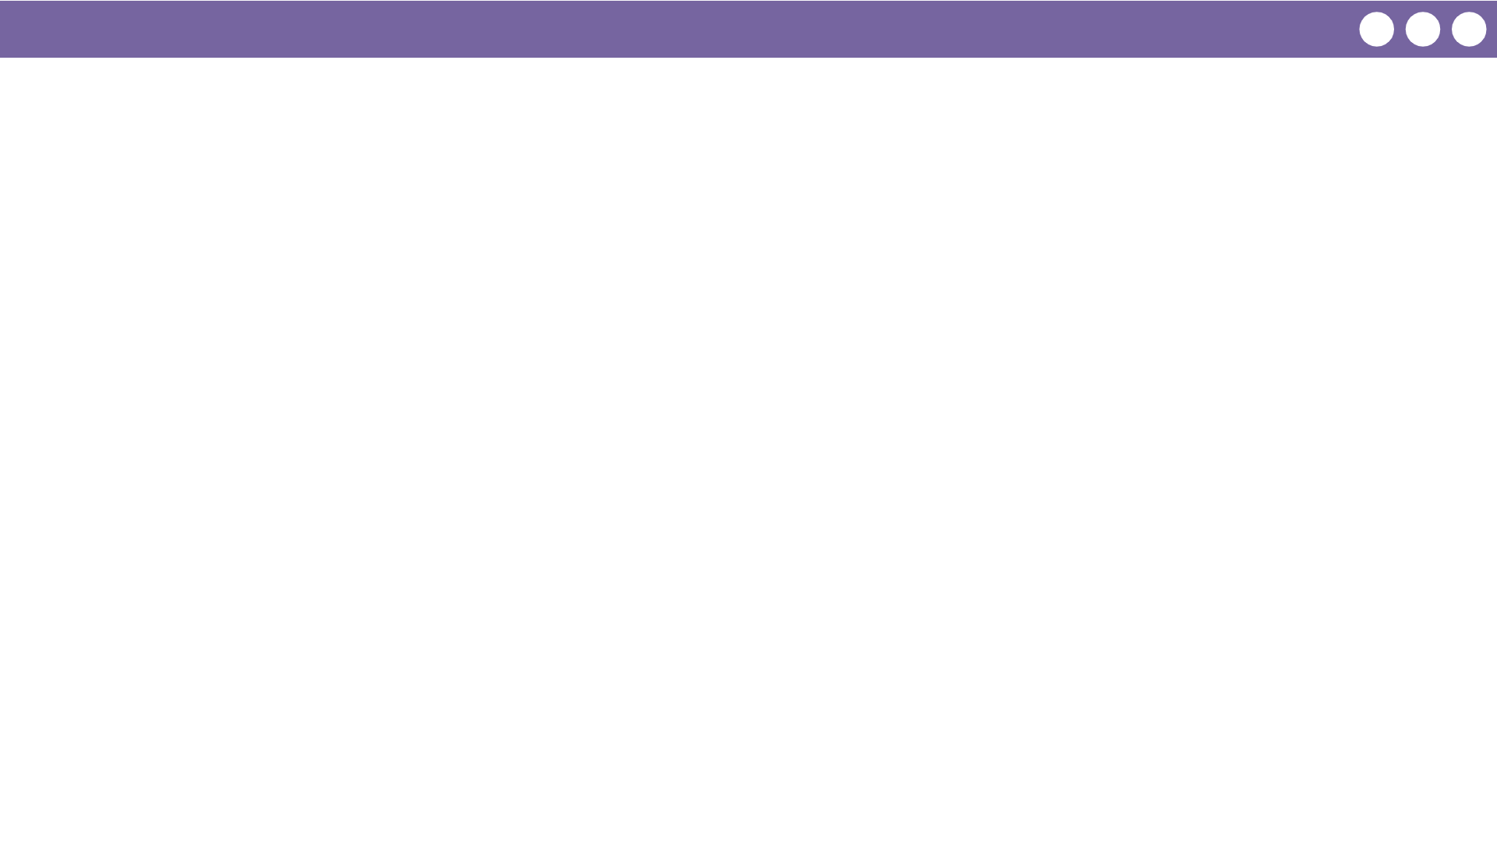
Unit 1 Lesson 2 - Wrap Up
Prompt: Think back to your simple two-option device from Challenge #1.
Instead of changing your device and adding more options every time you added more answers, how could you simply modify the way you use your device with only two options?

