Slide 1
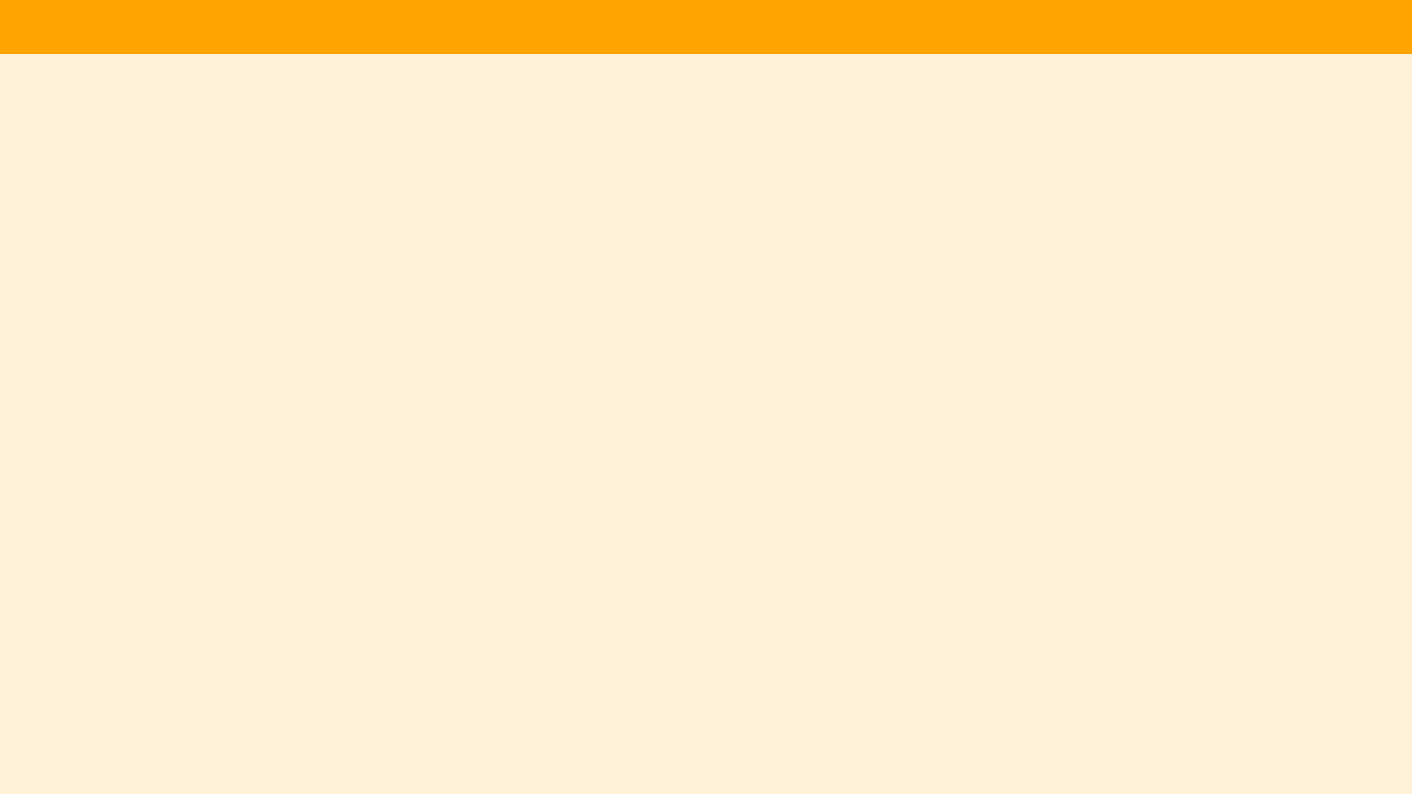
Unit 1 Lesson 1 - Set Up
Create a Code Studio account at:
studio.code.org
Teachers - put your join code here
Join our class section: studio.code.org/join/REPLACE

