Slide 1
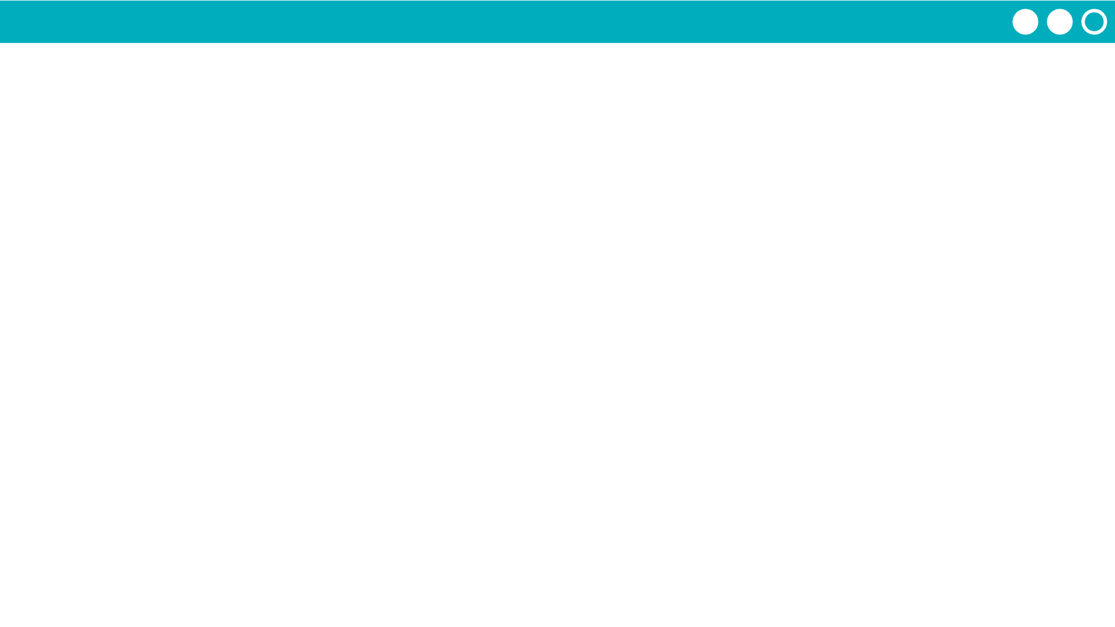
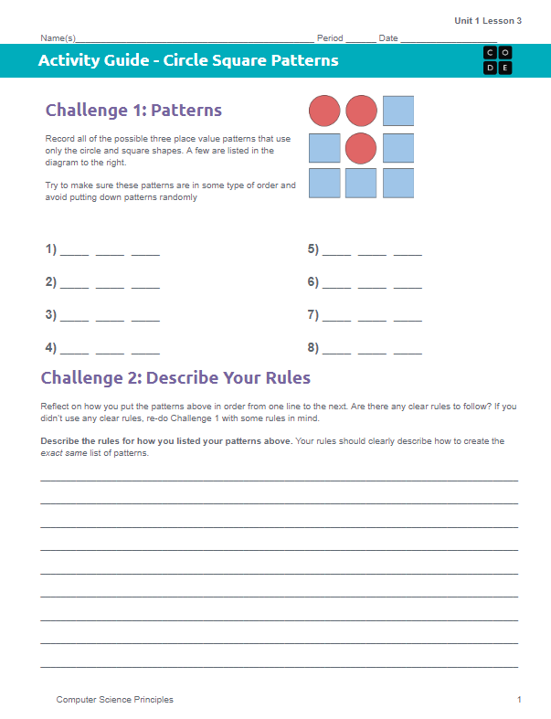
Unit 1 Lesson 3 - Activity
Circle Square Activity
You and your partner should have:
Circle Square Patterns - Activity Guide
Shape Cutouts

