Slide 1

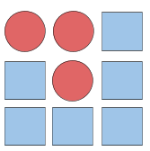
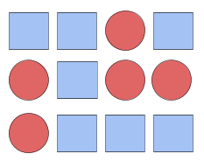
Unit 1 Lesson 3 - Activity
Do This: In your Activity Guide complete the following challenges.
Challenge 1: Patterns
Record all of the possible three place value patterns that use only the circle and square shapes. A few are listed in the diagram to the right. Try to make sure these patterns are in some type of order and avoid putting down patterns randomly.
Challenge 2: Describe Your Rules
Reflect on how you put the patterns above in order from one line to the next. Are there any clear rules to follow? If you didn’t use any clear rules, re-do Challenge 1 with some rules in mind. Describe the rules for how you listed your patterns above. Your rules should clearly describe how to create the exact same list of patterns.
Challenge 3: More Patterns
Use your rules from the last page to try and generate all possible four place value patterns using only circles and squares. Three examples are listed to the right. You may need to add new rules or slightly change your rules to account for all four place value patterns, but try to keep them as similar as possible.

