Slide 1
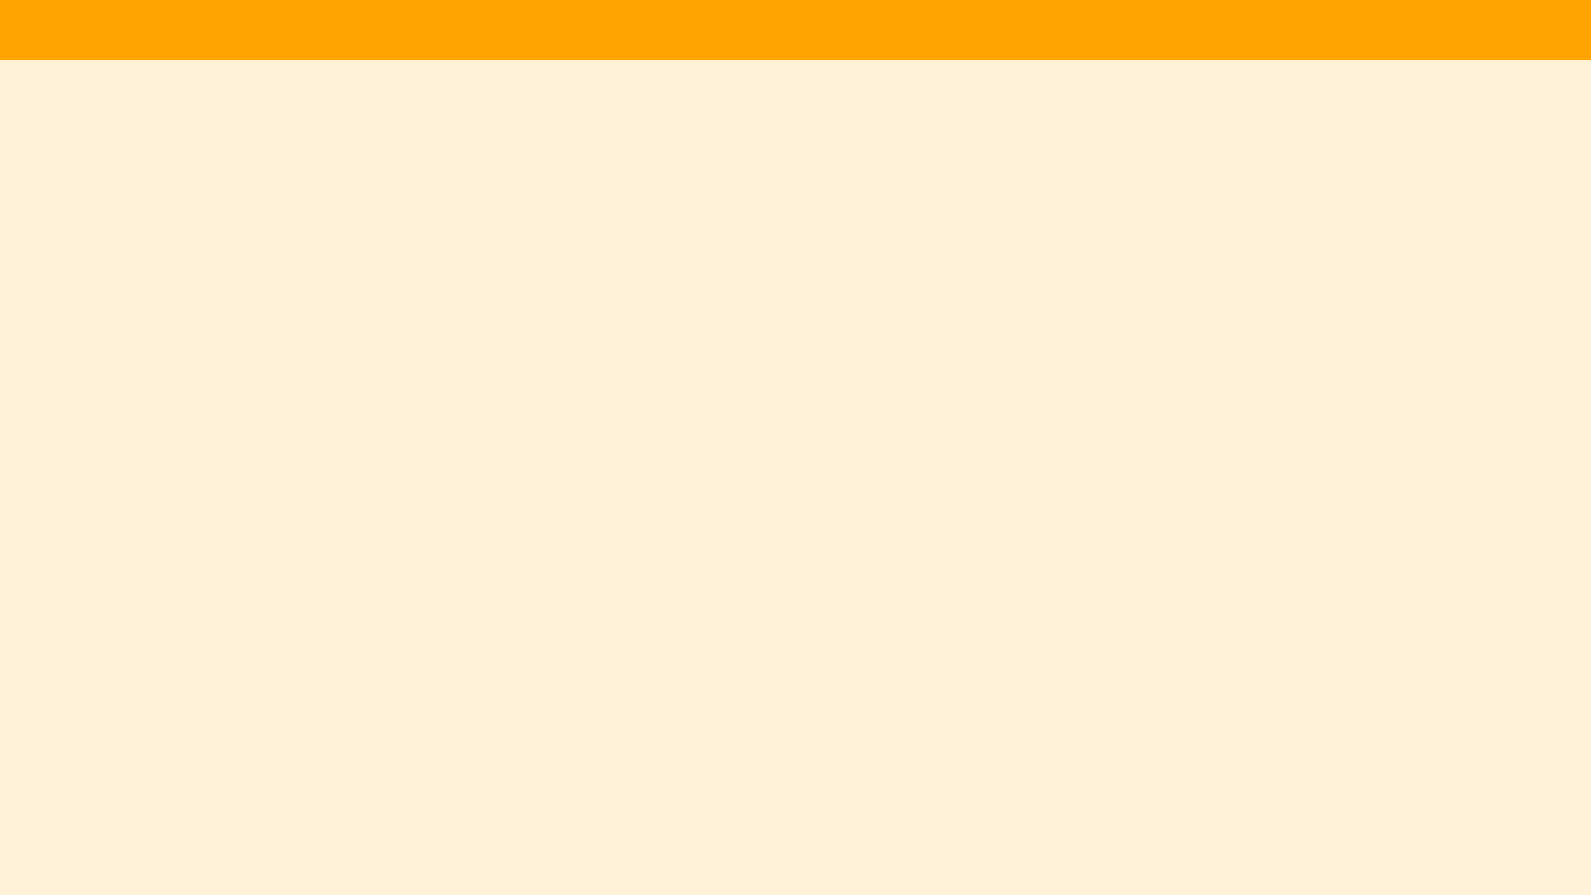
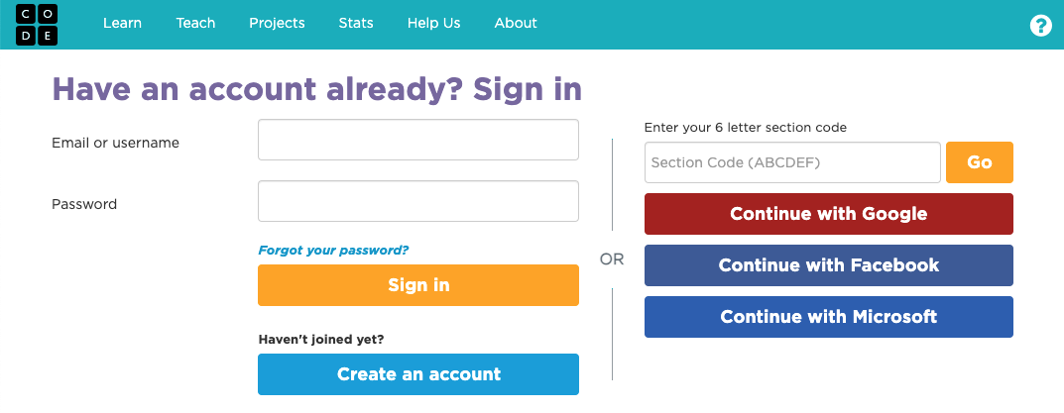
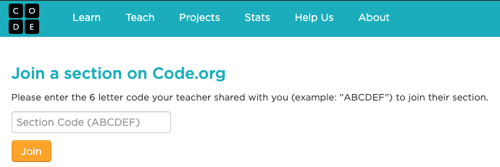
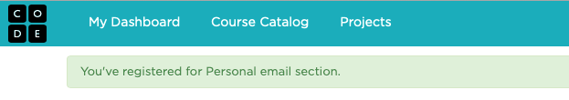
Unit 1 Lesson 1 - Set Up
Joining Code.org with a personal email account
If you don’t already have one, create a student Code.org account at studio.code.org/users/sign_up OR sign in with your existing account at studio.code.org/users/sign_in
Join your class section by clicking the link your teacher provides or going studio.code.org/join and typing in your section code. You only have to do this once. After you’ve successfully joined the section, you’ll be taken to the CSP course and see a green banner telling you that you have joined the section.

