Slide 1
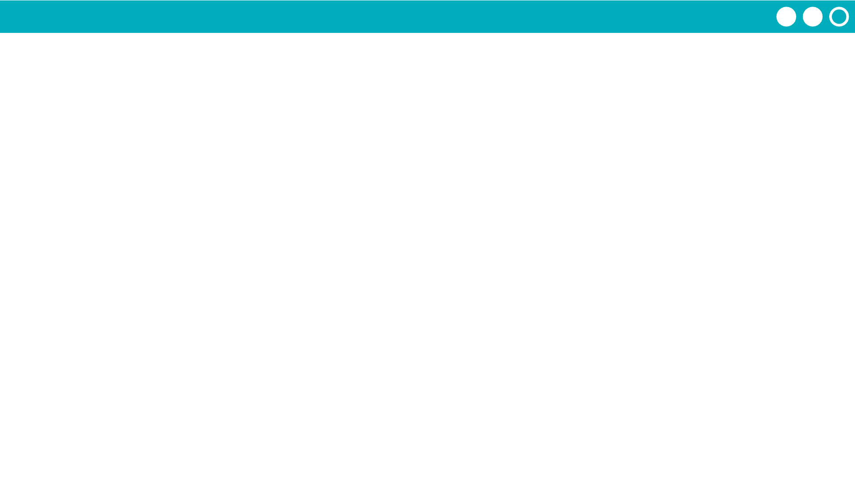
Unit 1 Lesson 4 - Activity
1 place value = Ten 1-shape patterns
0
1
2
3
4
5
6
7
8
9
← These are just shapes!

