Slide 1

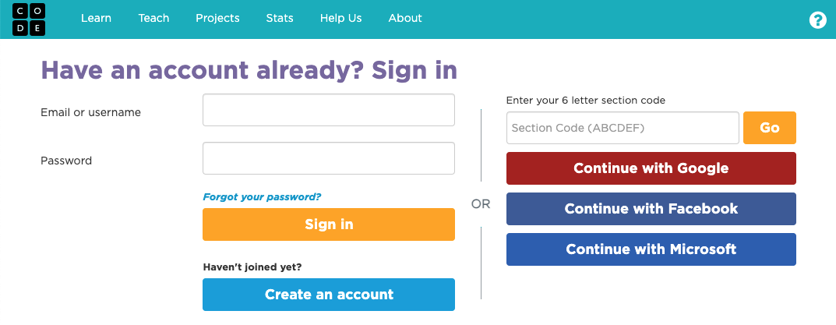
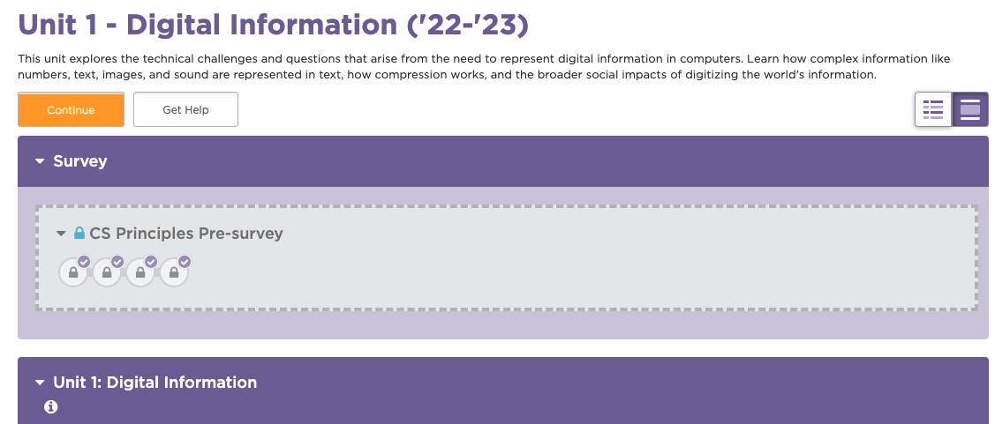
Unit 1 Lesson 1 - Set Up
Joining Code.org with a Google classroom account
To sign in at studio.code.org/users/sign_in, click the red ‘Continue with Google’ button to get started. Then use the Google Account you already use with Google Classroom to authenticate.
Your teacher has already added your account to their classroom section, so once you’re signed in, you should be taken directly to the CSP course.

