Slide 1
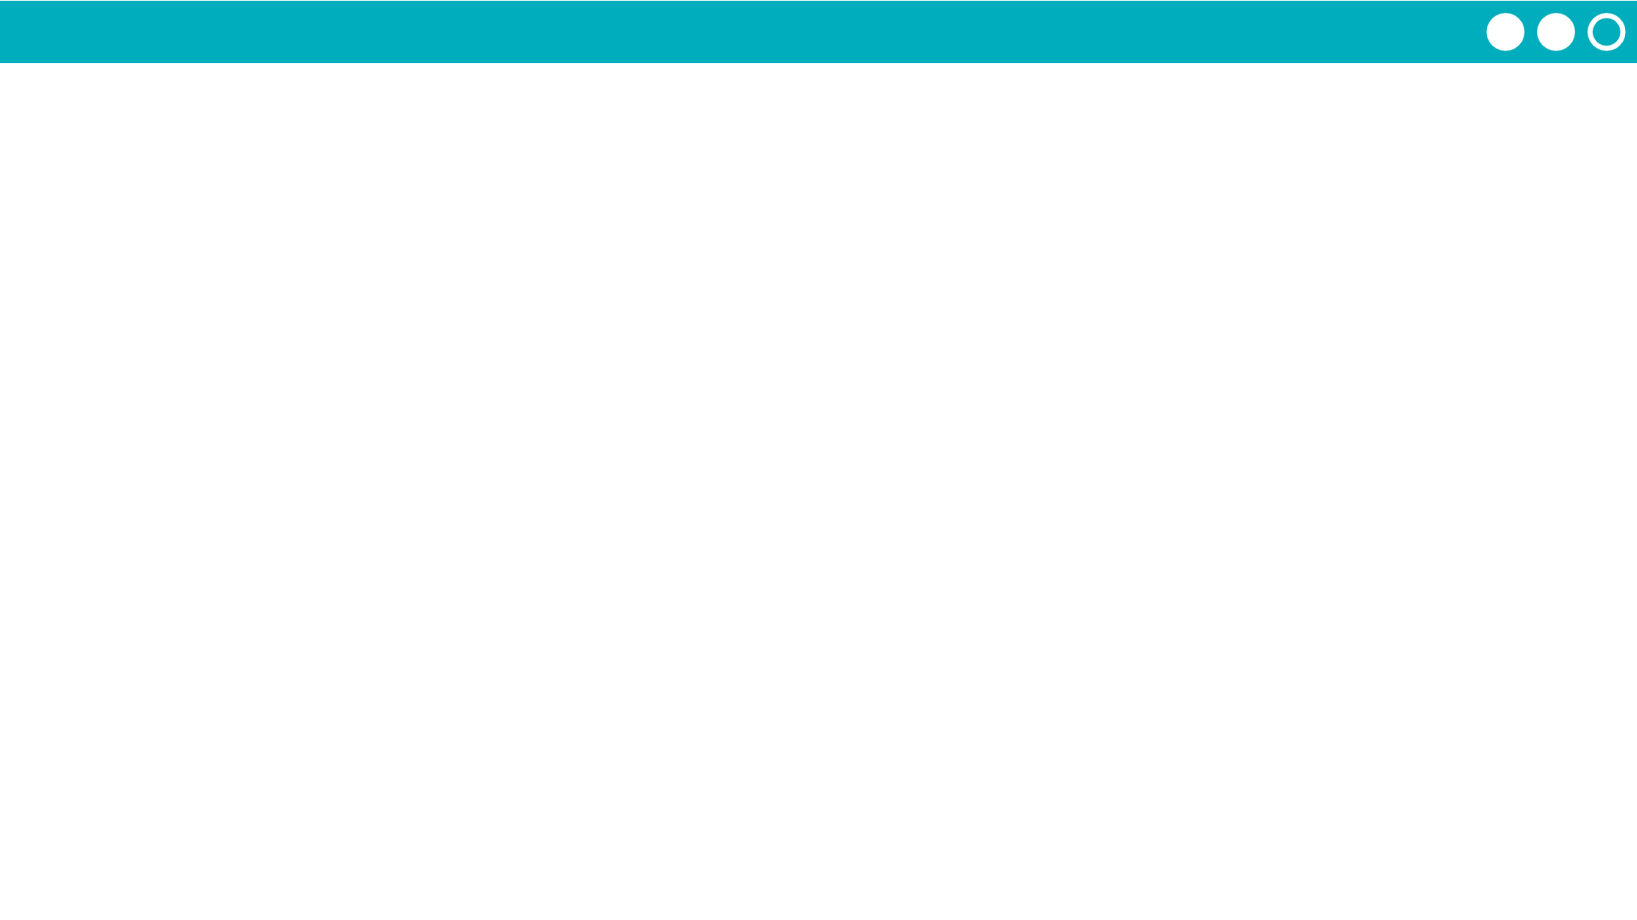
Unit 1 Lesson 4 - Activity
“Binary” is a number system with 2 shapes...
01

