Slide 1

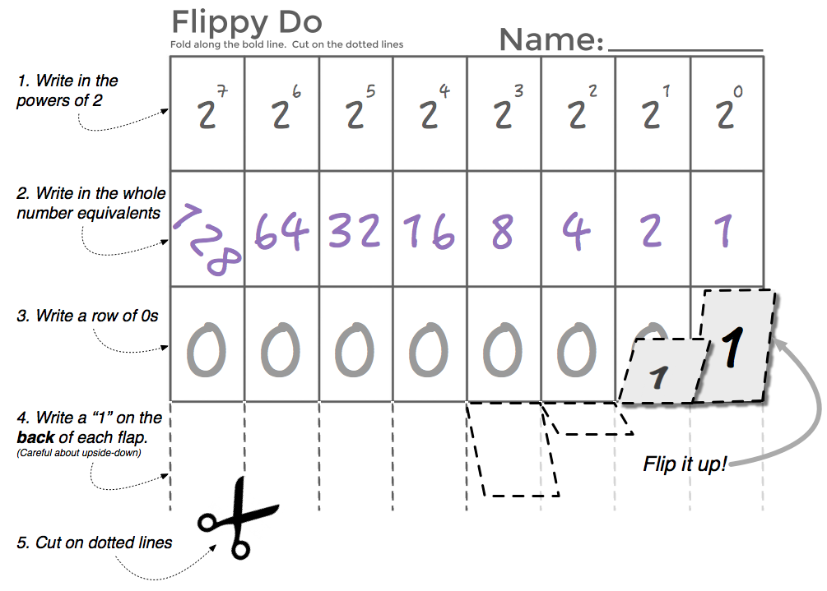
Unit 1 Lesson 4 - Activity
Make Your
Flippy Do!

