Slide 1
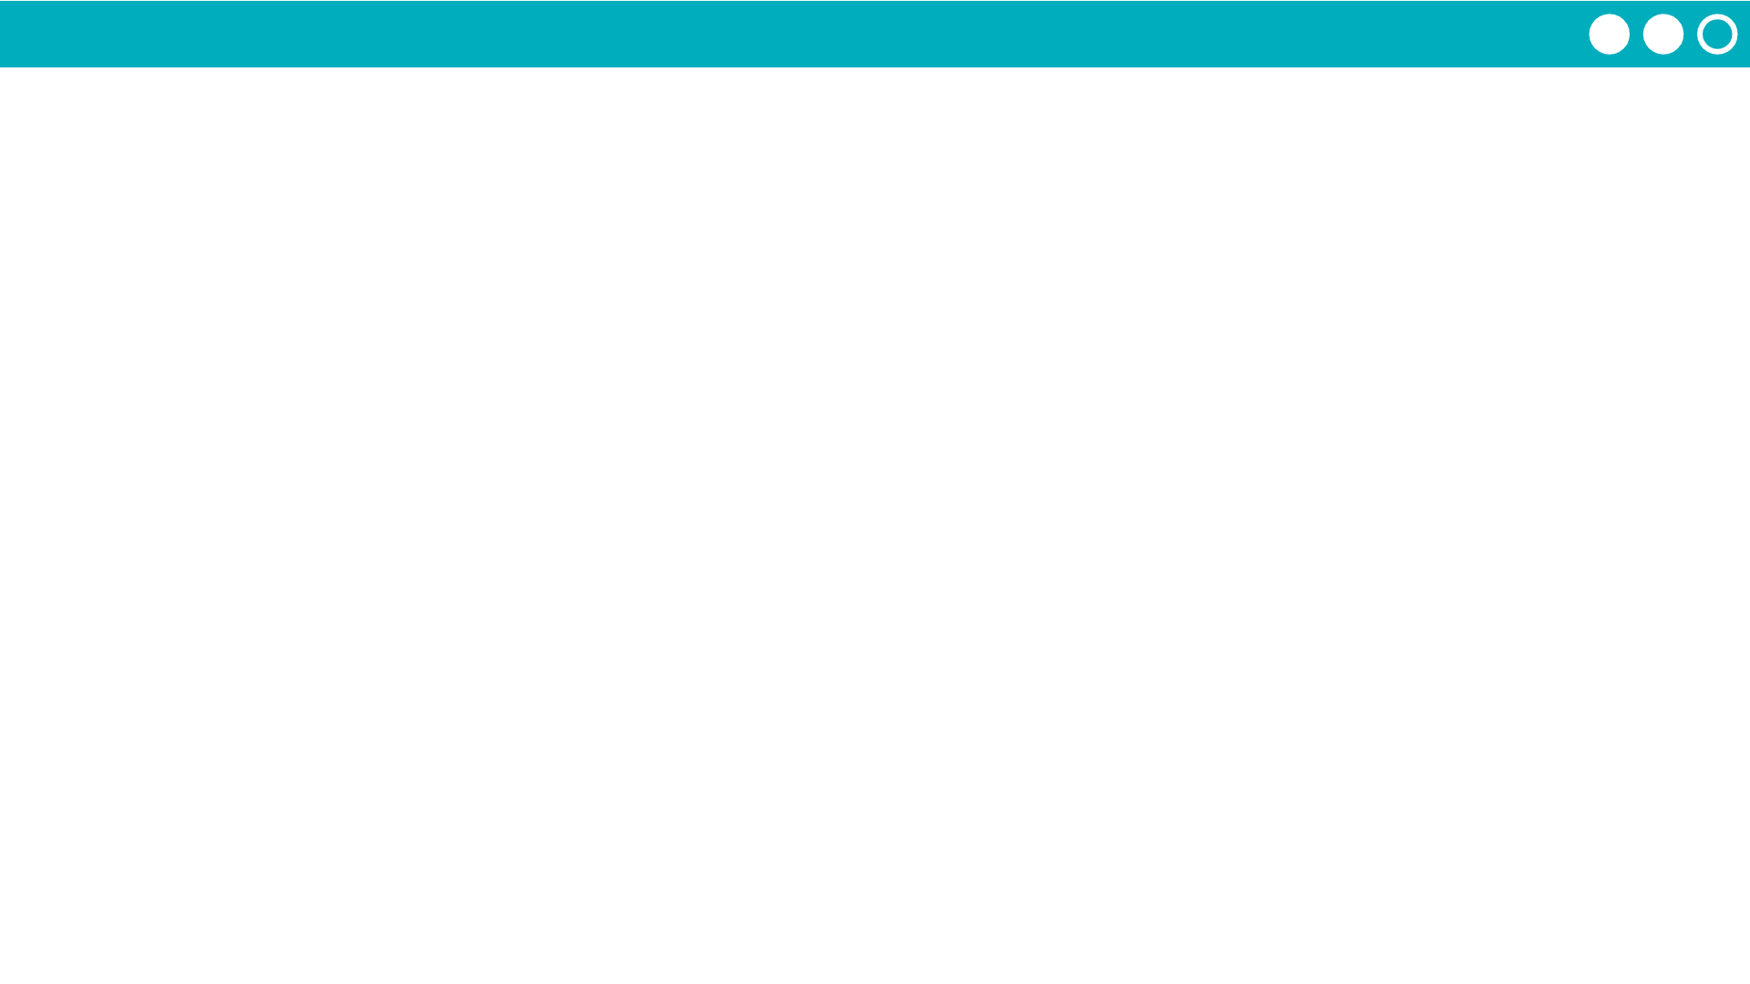
Unit 1 Lesson 4 - Activity
Try Out Your Flippy Do!
Represent these decimal numbers in binary
7
20
Represent these binary numbers in decimal
0001 0010
0001 1111
0000 0111
0001 0100
18
31

