Slide 1
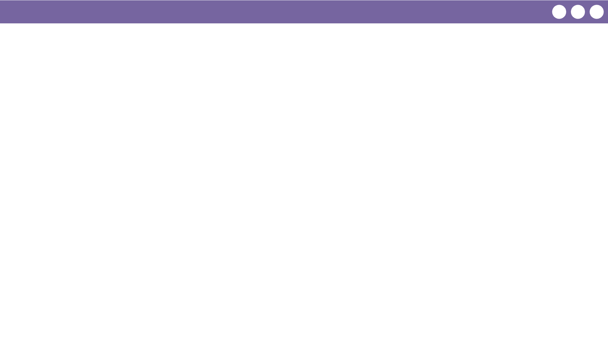
Unit 1 Lesson 4 - Wrap Up
Prompt: Now that we’ve had a chance to practice, let’s find out what we’ve learned and what we still have questions about. Write down:
3 things you learned today
2 things you found interesting
1 question you still have

