Slide 1

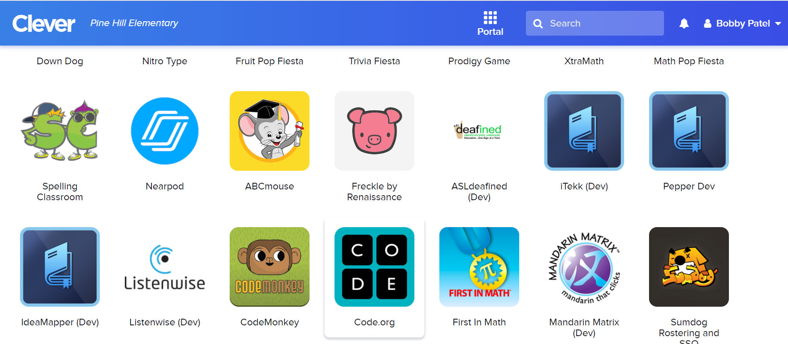
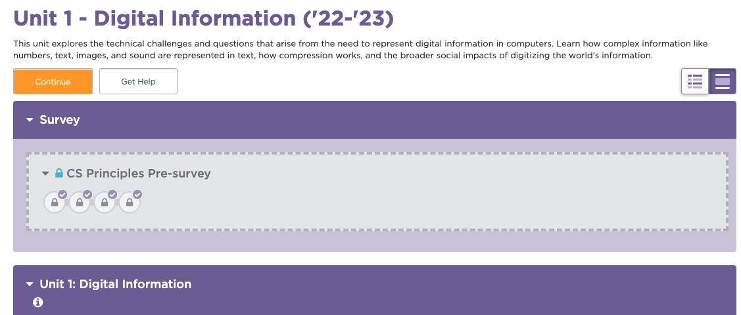
Unit 1 Lesson 1 - Set Up
Joining Code.org with a Clever account | [needed: screenshot of Clever dashboard]
Go to the Clever dashboard you already use in your classroom and click on the Code.org tile. This should redirect you to the Code.org site and sign you in!
Once you’re signed in, you should be taken directly to the CSP course.

