Slide 1

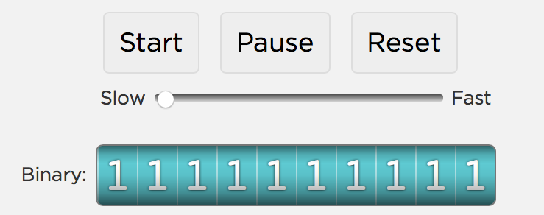
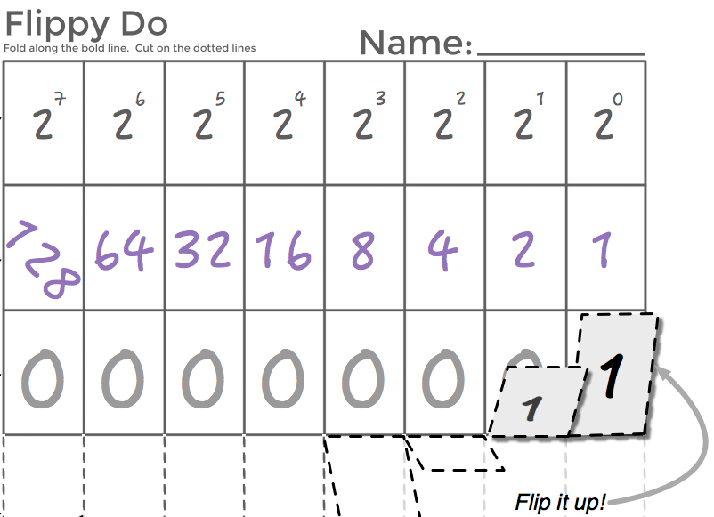

Unit 1 Lesson 5 - Activity
Overflow and Rounding
You and your partner should have:
Binary Odometer (Code.org website)
Flippy Do
Journal
Write responses to challenge questions in your journal!
AP CSP
Journal

