Slide 1
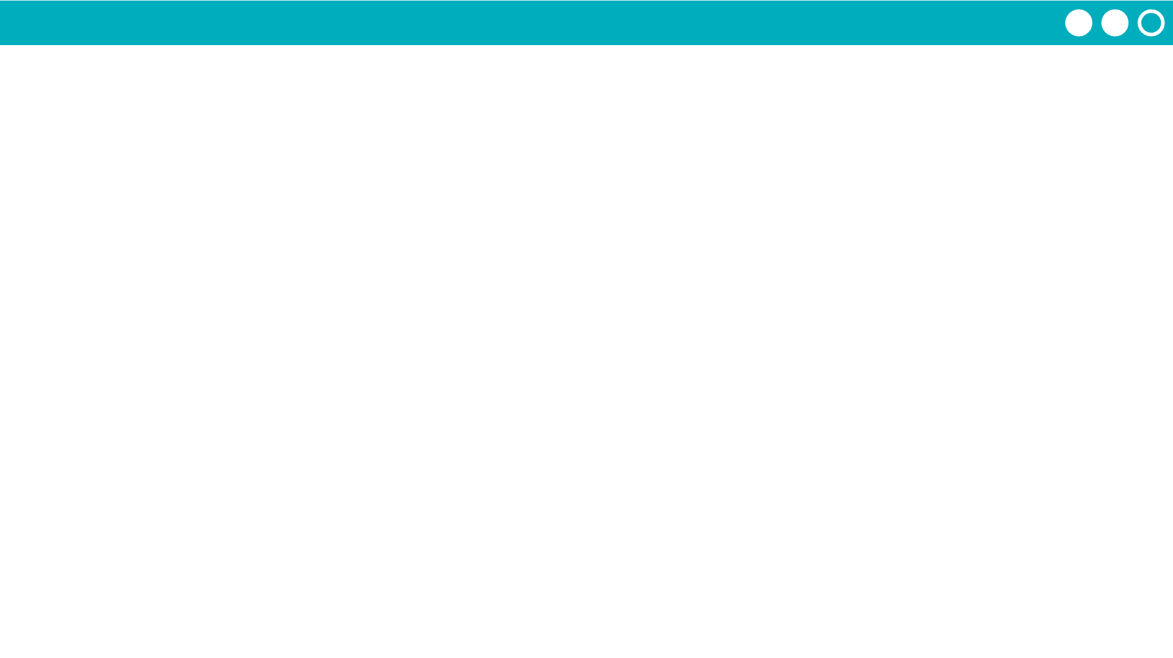
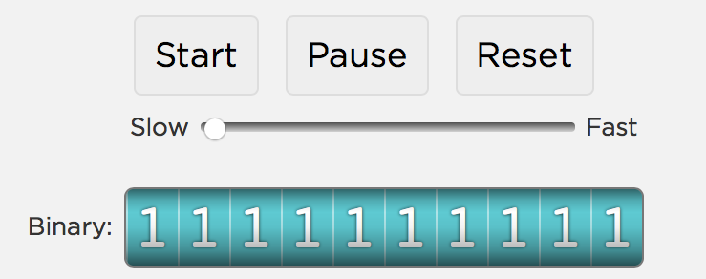
Unit 1 Lesson 5 - Activity
Do This:
Navigate to Level 1.
Play with the odometer to figure out how it works.

