Slide 1
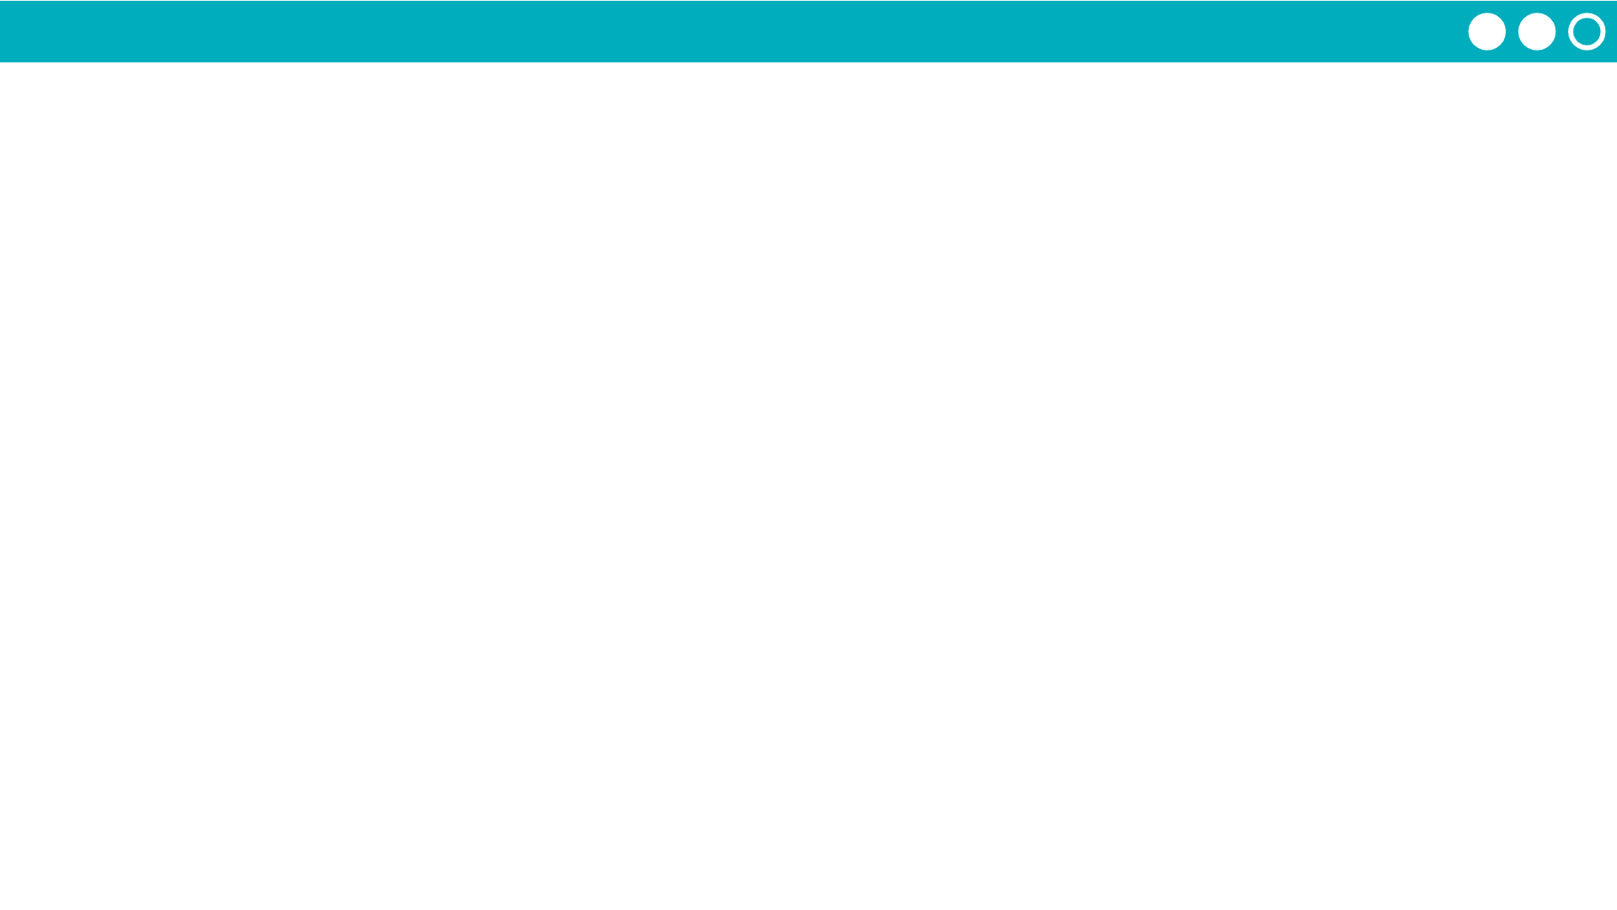
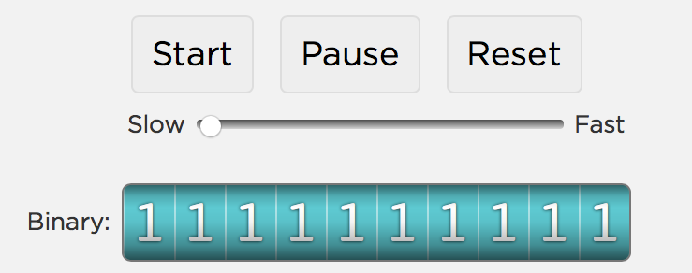
Unit 1 Lesson 5 - Activity
Do This:
Set the odometer to the highest number possible. Then let it run!

