Slide 1

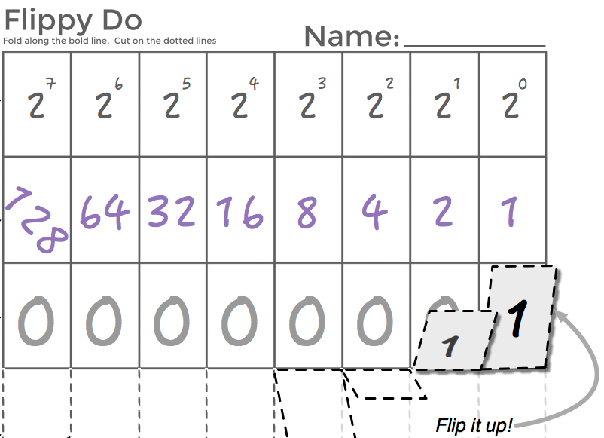

Unit 1 Lesson 5 - Activity
More Flippy Do Practice
What value would cause your Flippy-Do to overflow?
What adaptation could you make to the Flippy-Do to represent that value?
Using your newly adapted Flippy-Do, how many total numbers can be represented?
AP CSP
Journal

