Slide 1

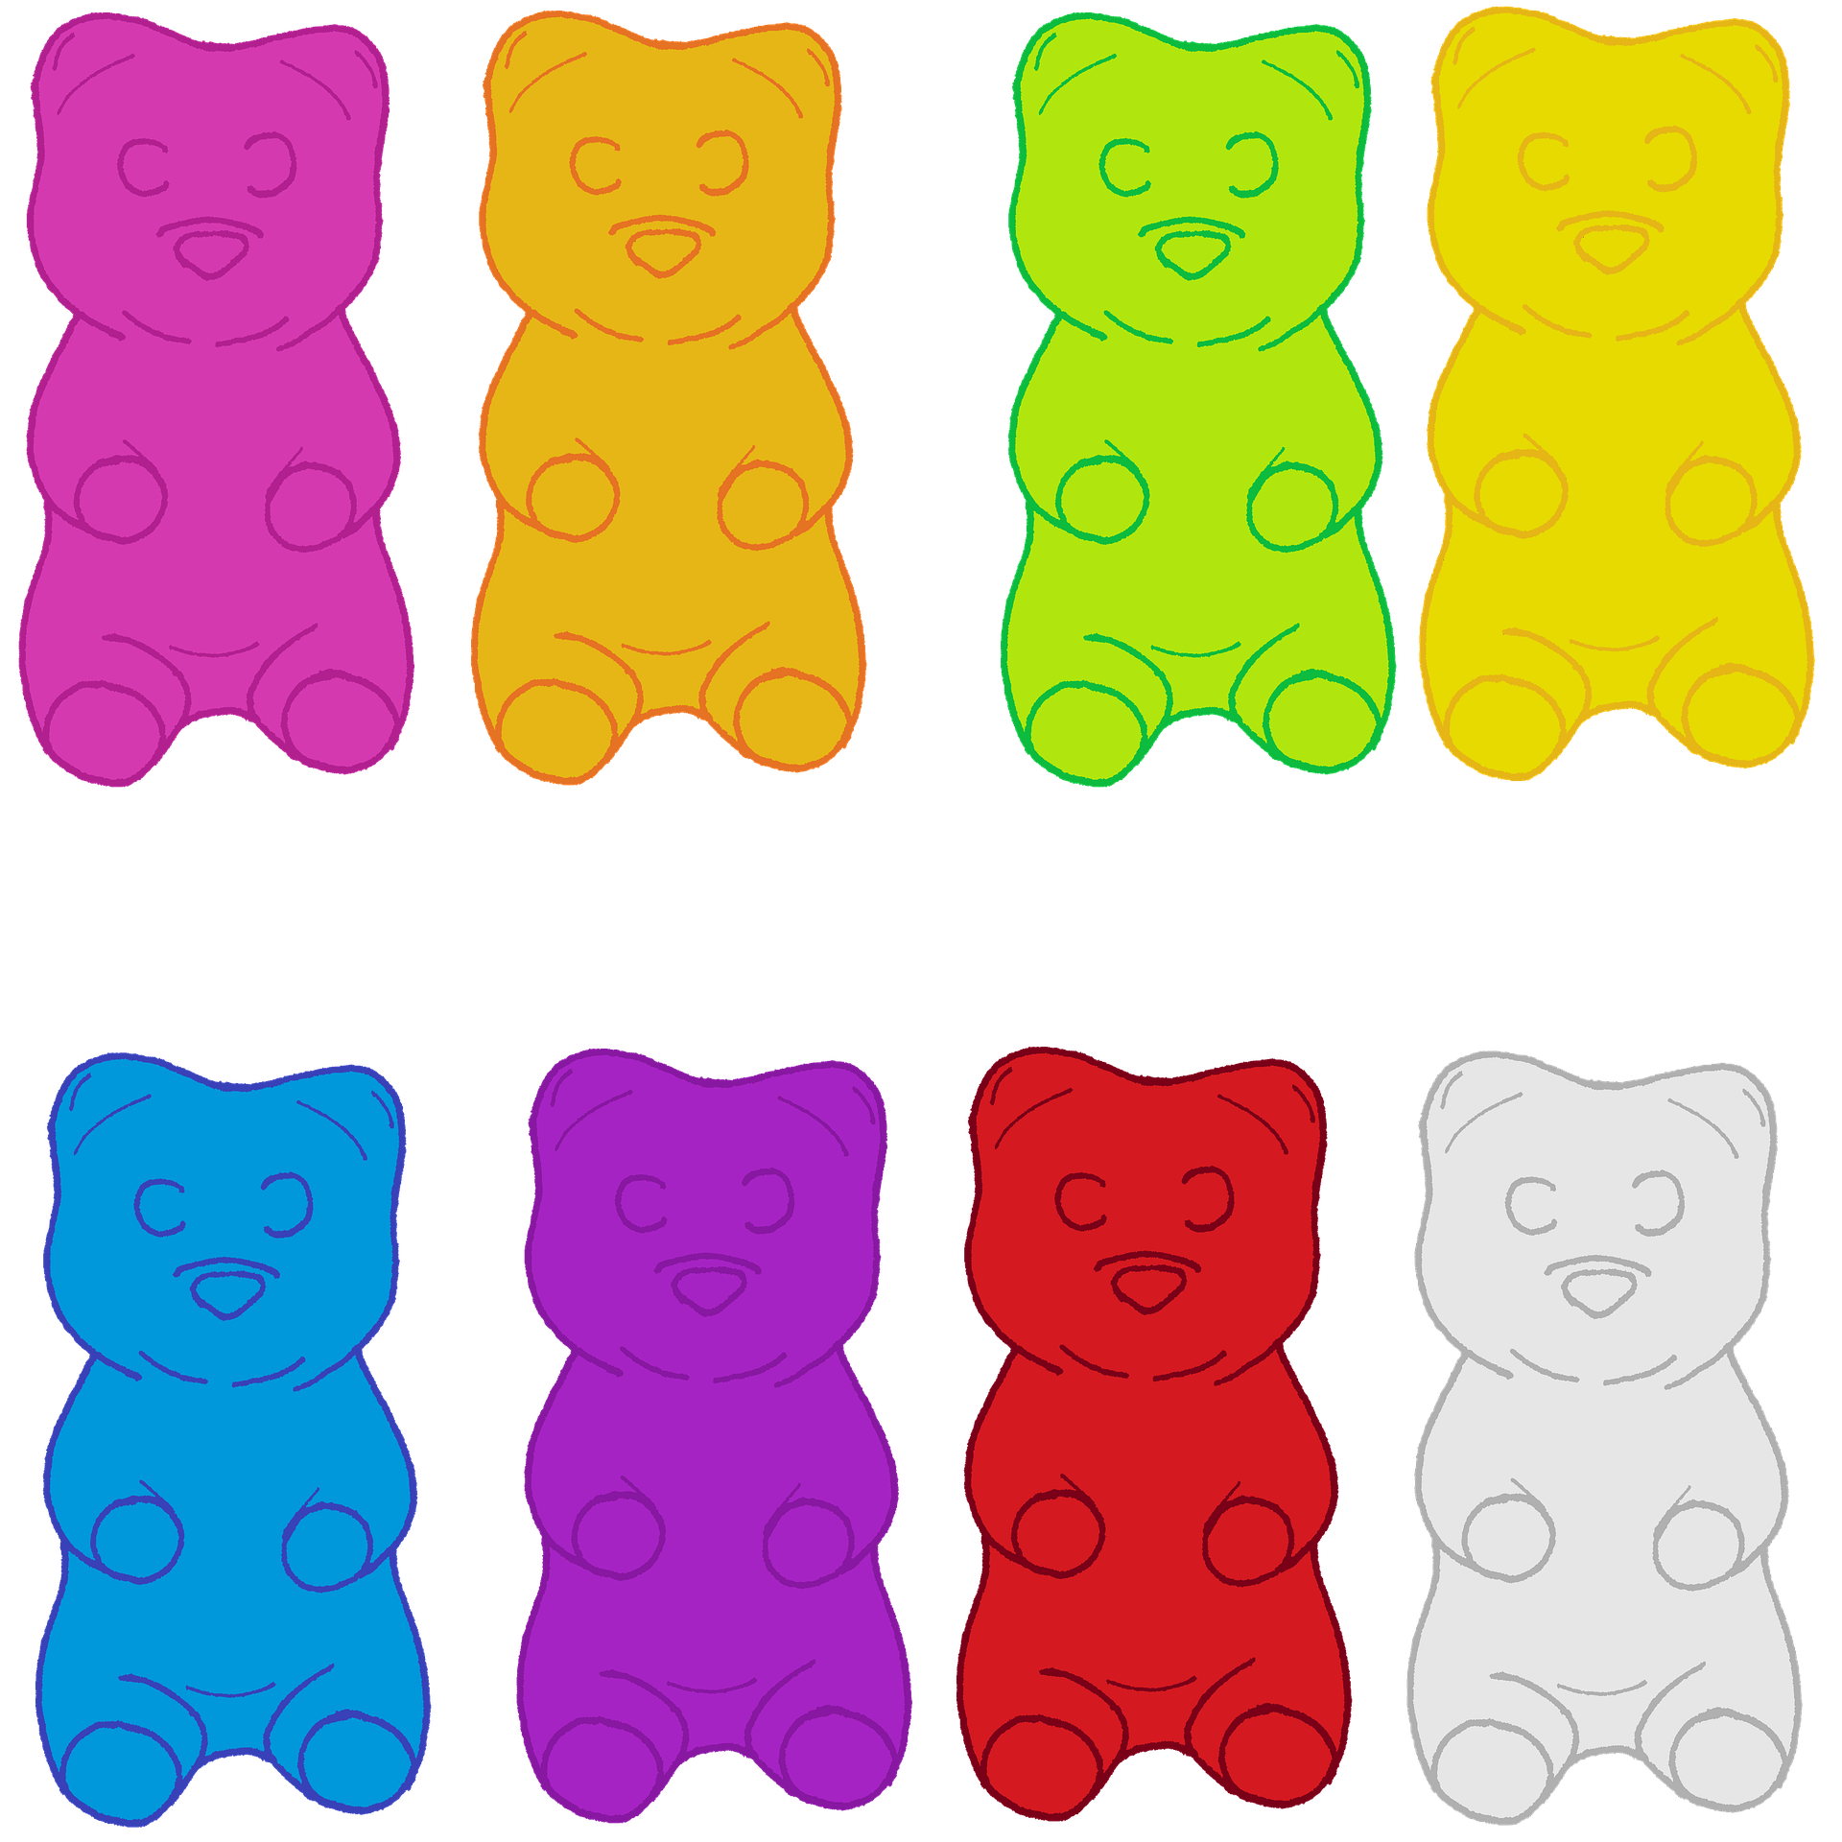

Unit 1 Lesson 5 - Activity
There are scales from two different manufacturers in the stores. They both use 4-bit binary numbers to store and display the weight of candy.
These bowls of gummy bears each weigh 3.3 pounds.
This scale always rounds the weight down to the next whole number.
This scale always rounds the weight up to the next whole number.
Prompt:
What problems could come from having both of these two types of scales in a single one of your stores?
0011 pounds
0100 pounds

