Slide 1
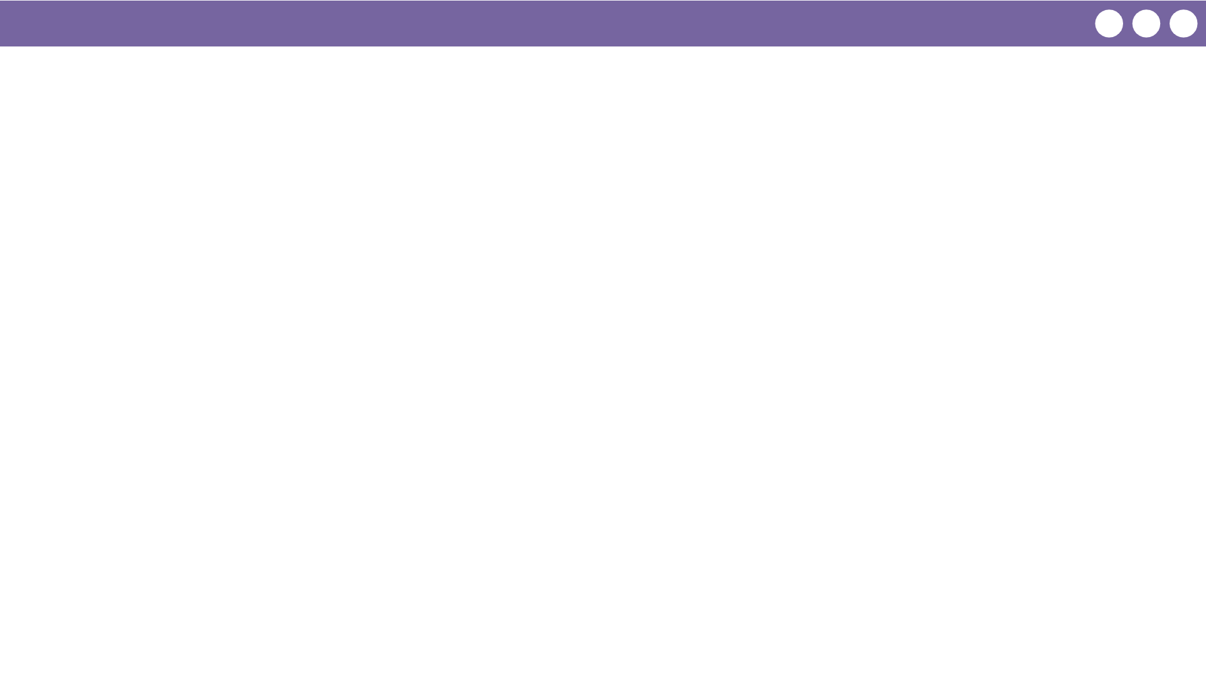
Unit 1 Lesson 5 - Wrap Up
Prompt:
What does the binary odometer show about representing large numbers?
If we had a big enough odometer or Flippy Do, could we represent every possible number?

