Slide 1
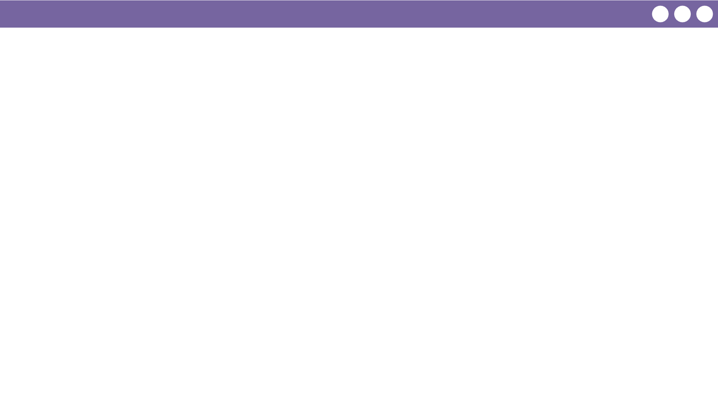
Unit 1 Lesson 5 - Wrap Up
With a fixed number of bits computers can only represent a fixed set of numbers.
Overflow Error: Error from attempting to represent a number that is too large.
Round-off Error: Error from attempting to represent a number that is too precise. The value is rounded.
Numbers that can be represented with 3 bits
0
000
1
001
2
010
3
011
4
100
5
101
6
110
7
111
8
???
9
???
10
???
11
???
12
???
13
???
1.48: Round-off error
11: overflow error

