Slide 1
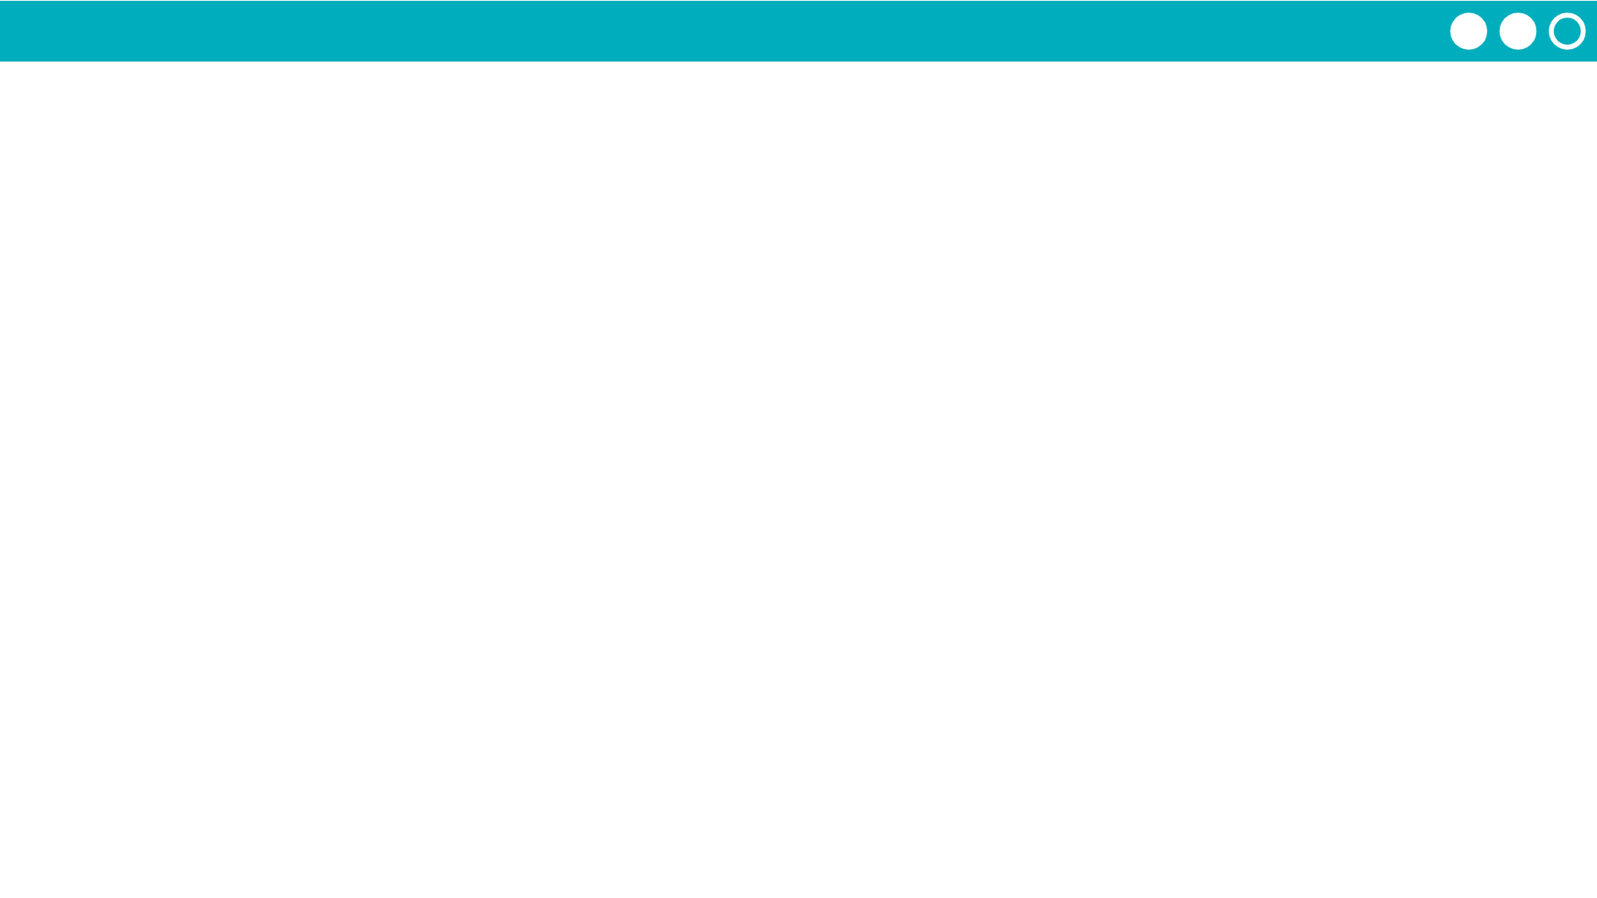
Unit 1 Lesson 6 - Activity
Do This: Look at the samples on the screen. Using only numbers, you will need to communicate these samples to a partner. No letters or characters allowed! Come up with a system that allows you to do this.
Text Samples
hey
ttyl
morning

