Slide 1
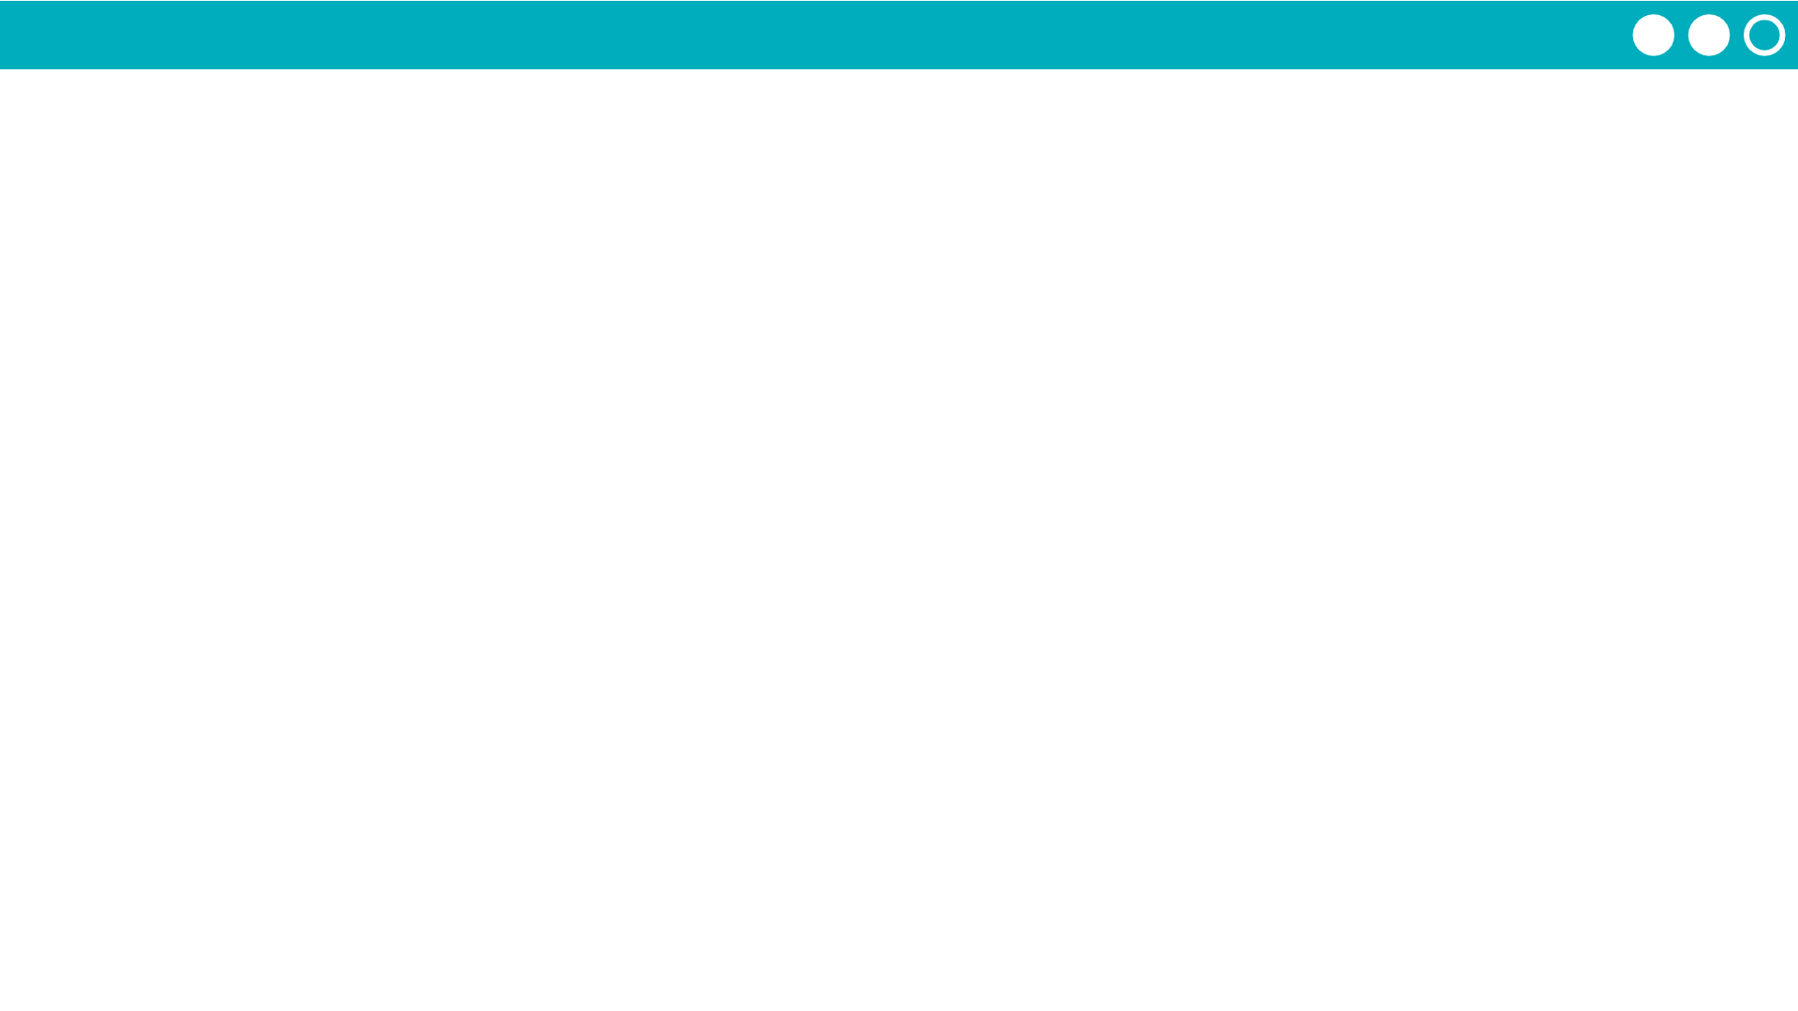
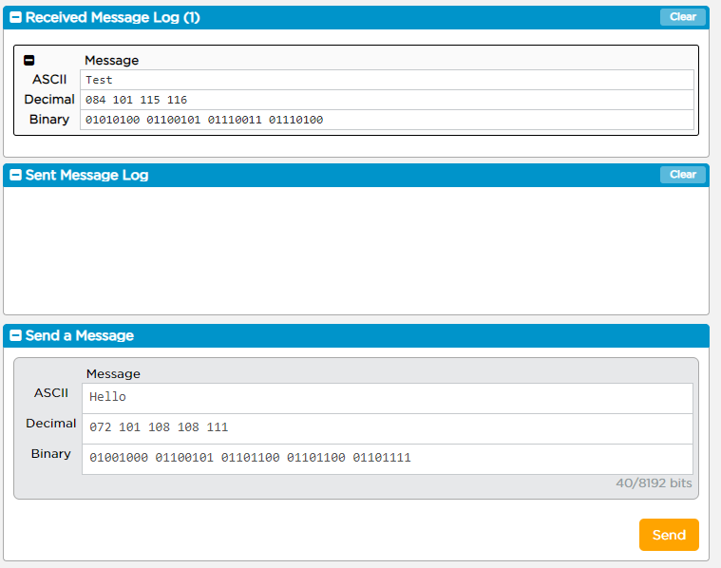
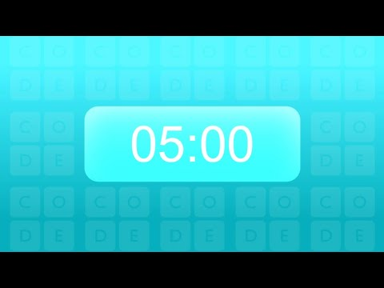
Unit 2 Lesson 1 - Activity
Do This:
Explore the Internet Simulator. How does it work? What can I do with it?

