Slide 1

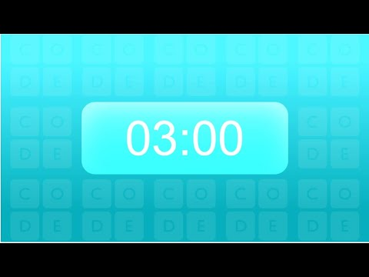




Unit 2 Lesson 7 - Activity
Step 1: Choose!
Net Neutrality
Internet Censorship
The Digital Divide

