Slide 1

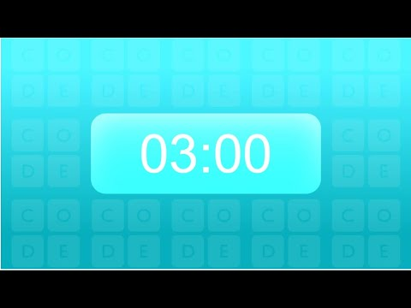
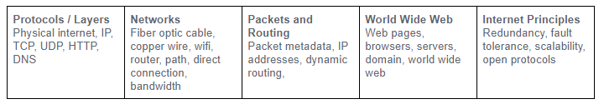
Unit 2 Lesson 7 - Activity
Step 3: Review the Concept Bank

