Slide 1

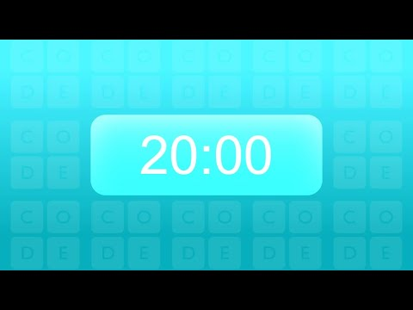
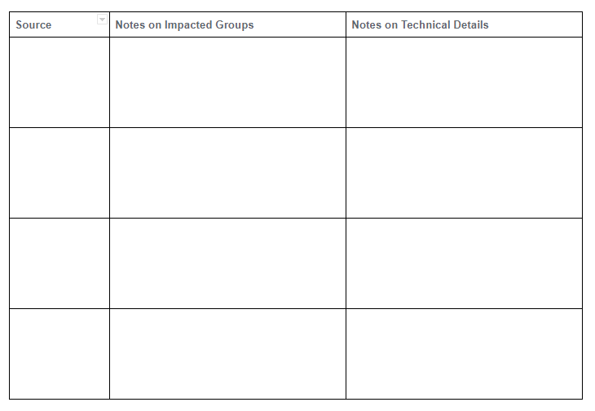
Unit 2 Lesson 7 - Activity
Step 4: Review Your Sources

