Slide 1
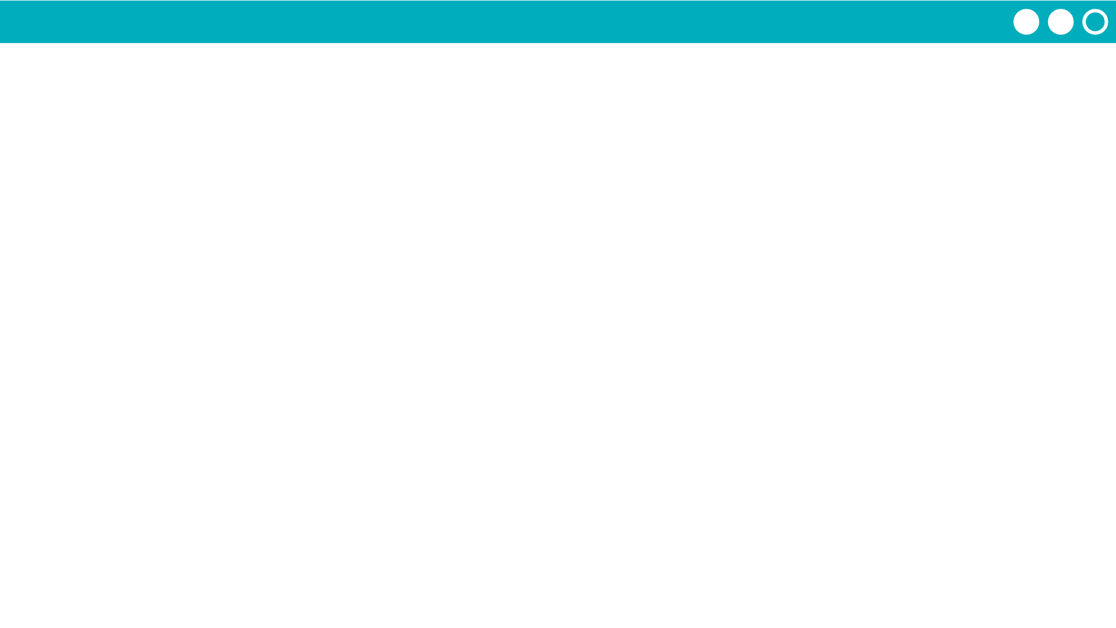
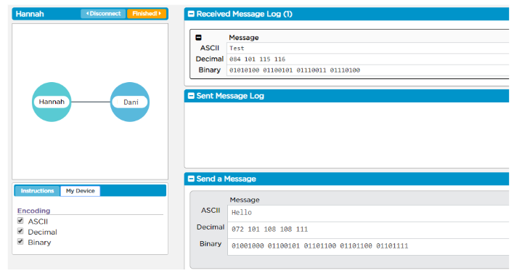
Unit 2 Lesson 1 - Activity
Teacher Demo

