Slide 1

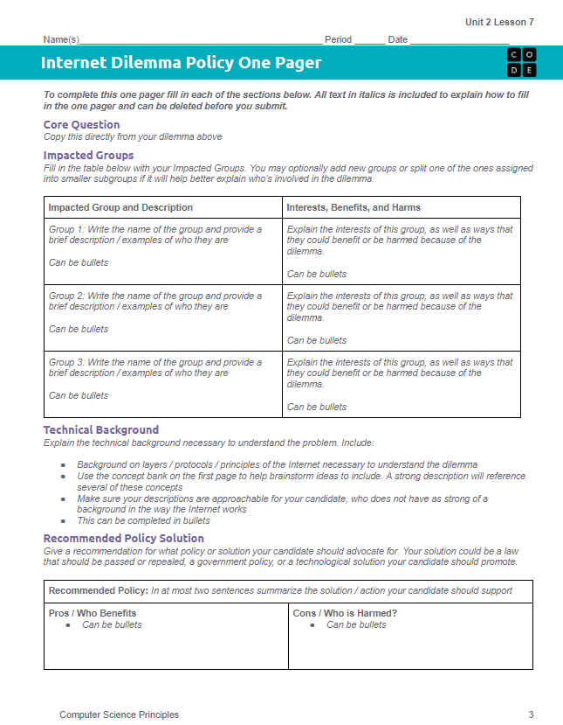
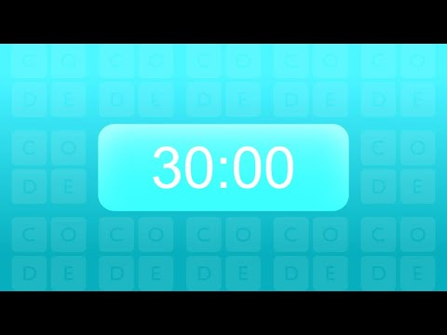
Unit 2 Lesson 7 - Activity
Internet Dilemma Policy One Pager
Don't forget to check the rubric as you work!

