Slide 1

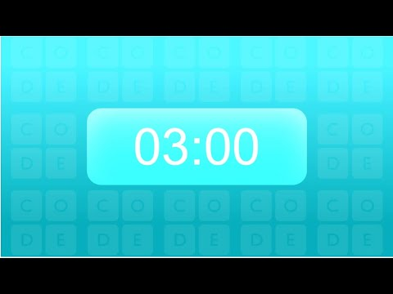
Unit 2 Lesson 2 - Activity
Challenge #1: As a group, create a network where everyone can speak directly to everyone else.

