Slide 1

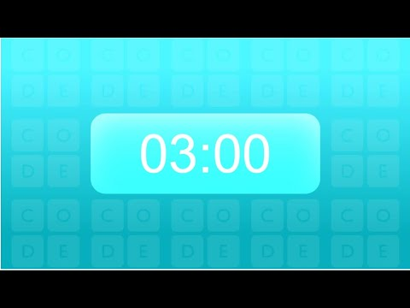
Unit 2 Lesson 2 - Activity
Guideline A: Strings cost money, so try to use the least number of strings possible
Challenge #2: As a group, create a network that uses the least number of strings.

