Slide 1

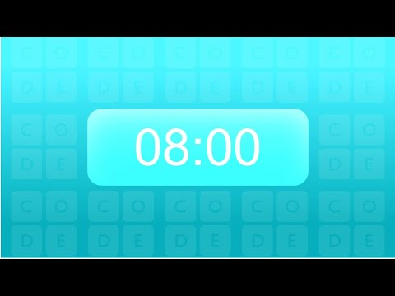
Unit 2 Lesson 2 - Activity
Guideline A: Strings cost money, so try to use the least number of strings possible
Guideline B: Strings can be cut, which might disconnect people from the network
Challenge #3: As a group, create a network that keeps everyone connected even if one of the lines is cut

