Slide 1

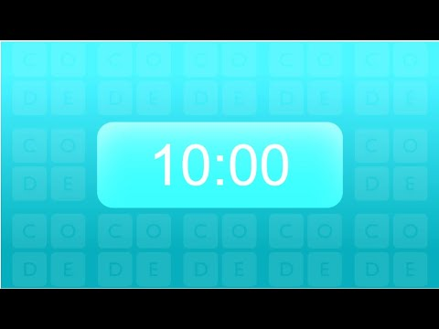
Unit 2 Lesson 2 - Activity
Guideline A: Strings cost money, so try to use the least number of strings possible
Guideline B: Strings can be cut, which might disconnect people from the network
Guideline C: Direct Connections are faster than long paths with indirect connections
Challenge #4: As a group, create a network that you feel balances all 3 guidelines.

