Slide 1


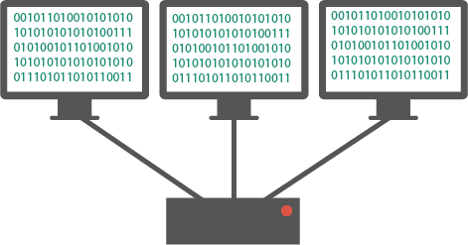
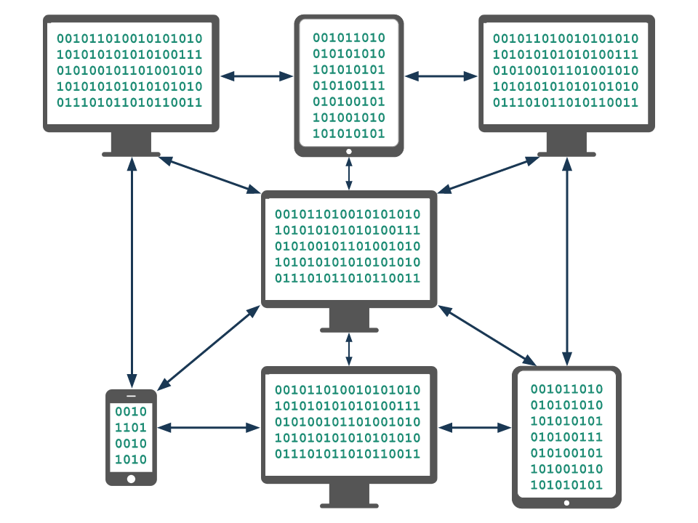
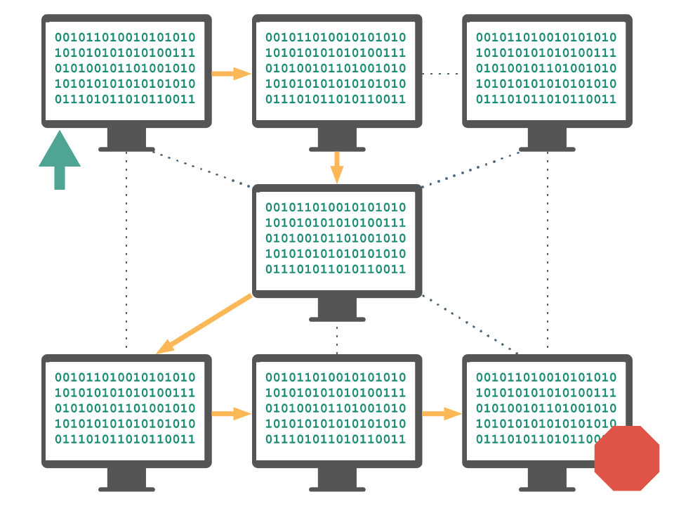
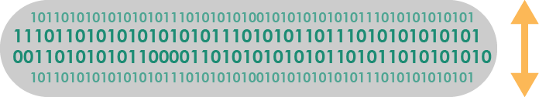
Unit 2 Lesson 2 - Wrap Up
Computing Device: a machine that can run a program, including computers, tablets, servers, routers, and smart sensors
Computing System: a group of computing devices and programs working together for a common purpose
Computing Network: a group of interconnected computing devices capable of sending or receiving data.
Path: the series of connections between computing devices on a network starting with a sender and ending with a receiver.
Bandwidth: the maximum amount of data that can be sent in a fixed amount of time, usually measured in bits per second.

