Slide 1


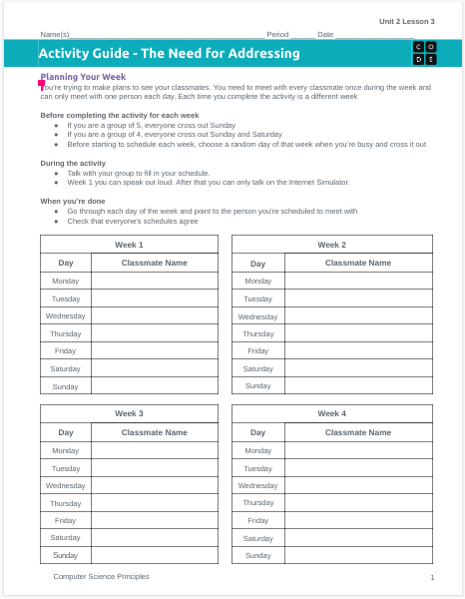
Unit 2 Lesson 3 - Activity
The Need for Addressing
You should have:
Activity Guide
Pen or pencil

