Slide 1
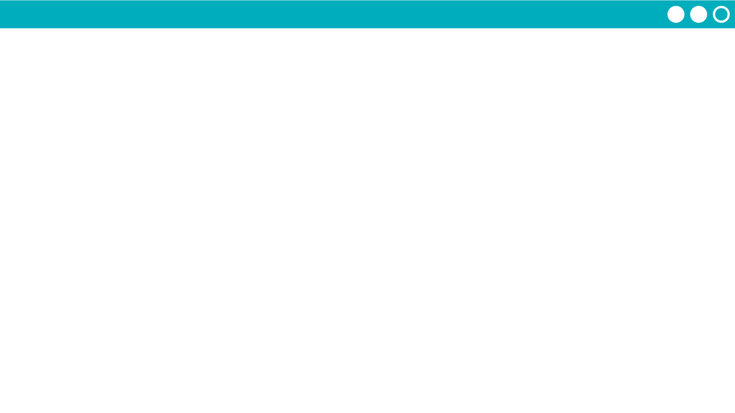
Unit 2 Lesson 3 - Activity
Do This: With your group follow the directions given in the box for Week 1
If you are a group of 5, everyone cross out Sunday
If you are a group of 4, everyone cross out Sunday and Saturday
Before starting to schedule each week, choose a random day of that week when you’re busy and cross it out
Once your group is ready, fill in your schedules.
Week 1
Day | Classmate Name
Monday
Tuesday | XXXX BUSY XXXX
Wednesday
Thursday
Friday
Saturday | XXXXXXXXXXX
Sunday | XXXXXXXXXXX

