Slide 1
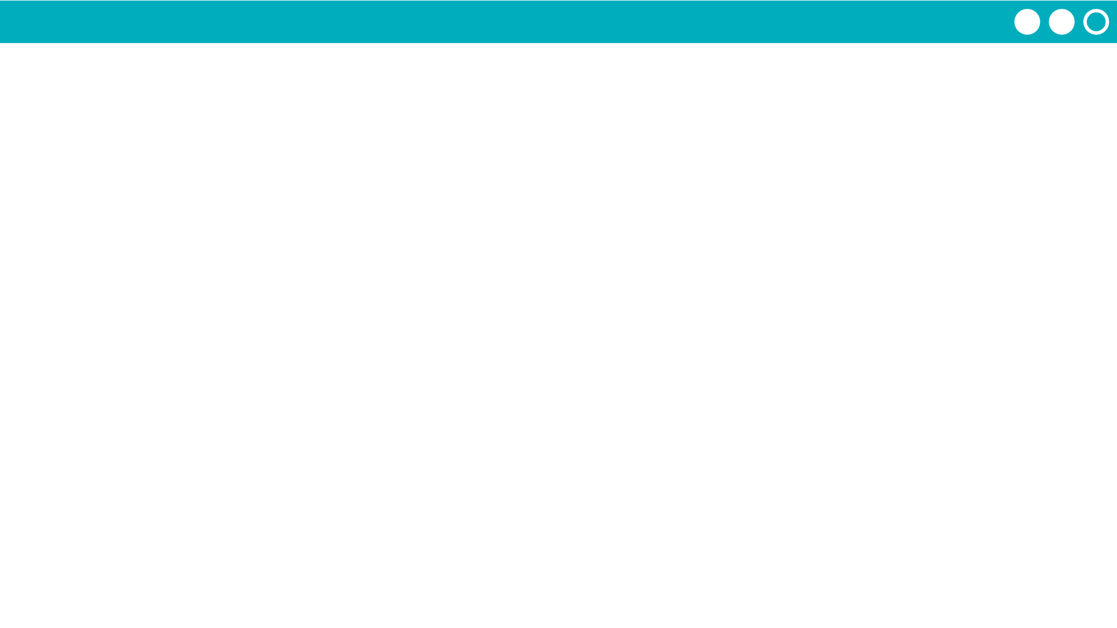
Unit 2 Lesson 3 - Activity
Prompt: With your group check that everyone's schedules match. Then discuss what worked well, what made this tricky, if there's anything you want to try differently in Week 2.

